Slide 1
D.3 Function of the liver

Slide 2
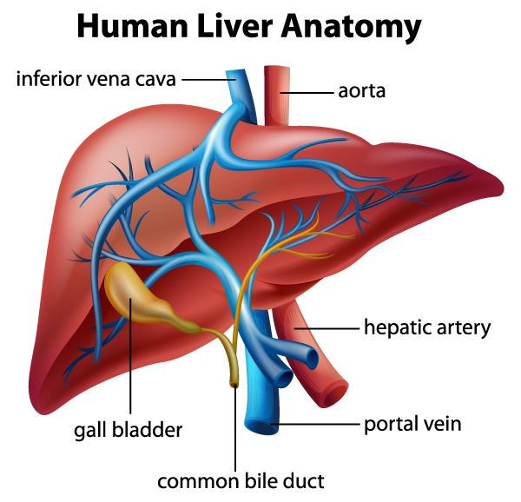
Blood supply to the liver
Dual blood supply to the liver and differences between sinusoids and capillaries.
Hepatic artery branches from the aorta bringing oxygen rich blood from the heart.
Hepatic portal vein brings blood from the stomach and intestine to the liver.

Slide 3
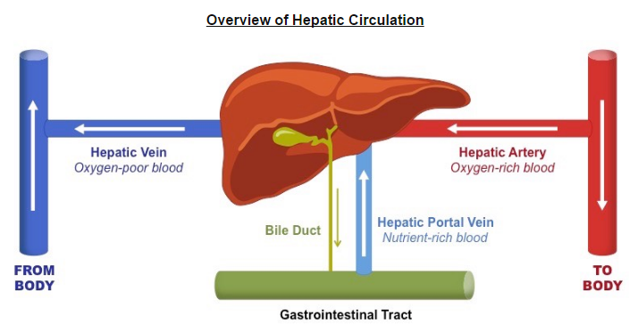
Processing nutrients by the liver
The liver intercepts blood from the gut to regulate nutrient levels.
One of the main functions of the liver is to regulate the quantity of nutrients circulating the blood.
The liver regulates blood glucose levels, either by storing it or releasing it.

Slide 4
Storage of nutrients in the liver
Some nutrients in excess can be stored in the liver.
When levels of glucose are high, insulin is released.
The insulin stimulates hepatocytes to take up the glucose an store it as glycogen.
When the levels fall, hormones such as glucagon will be released.
This results in the breakdown of glycogen, glycerol, amino acids and fatty acids.
Iron, retinal (vitamin A), and calciferol (vitamin D) are stored in the liver when in excess and released when there is a deficit in the blood.

Slide 5
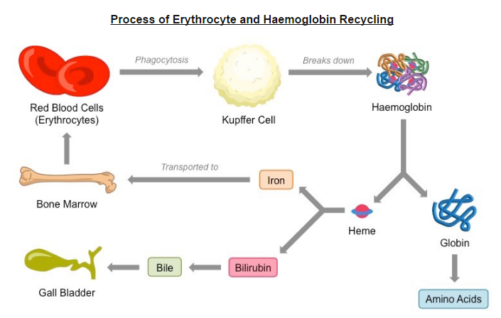
Recycling of red blood cells
Components of red blood cells are recycled by the liver.
The typical lifespan of an erythrocyte (RBC) in an adult is about 120 days.
The old and damaged RBC undergo changes in their plasma membrane which make them susceptible to recognition by macrophages.

Slide 6
Kupffer Cells
The breakdown of erythrocytes starts with phagocytosis of red blood cells by Kupffer cells.
As RBC age, they swell and some are engulfed by Kupffer cells, which are macrophages which linen the sinusoids in the liver.
Inside the Kupffer cell, the hemoglobin molecule is split into globin chains and a heme group.
Amino acids form the globin chain are recycled, while heme group is further broken down into iron and bilirubin.

Slide 7
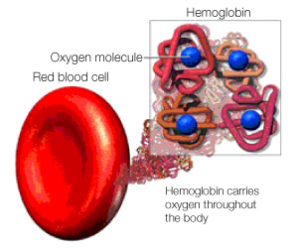
Transport of iron to bone marrow
Iron is carried to the bone marrow to produce hemoglobin in new red blood cells.
Hemoglobin is synthesized in red blood cells, and iron is added to the heme group.
Iron is essential for red blood cell function as it is a component of the hemoglobin molecule but it is toxic at high concentrations.

Slide 8
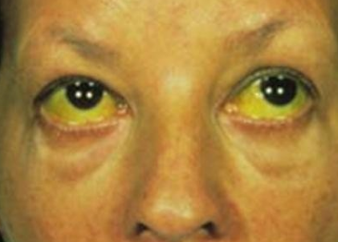
Jaundice
Causes and consequences of jaundice.
When RBC are broken down in the liver and the spleen, hemoglobin is released.
Macrophages digest hemoglobin into heme and globin.
The globin is digested into a.a which are recycled.
The heme group is further converted to iron and a yellow pigment called bilirubin.
Any bilirubin that is not broken down (due to interference of metabolism or excretion of bilirubin) will build it in the blood.
Resutling in yellowing of eyes and skin.
Jaundice is seen in liver diseases such as hepatitis or liver cancer.
Newborns also have this.

Slide 9
Conversion of cholesterol to bile salts
Surplus cholesterol is converted to bile salts.
Although cholesterol is absorbed from food in the intestine, a large quantity is synthesized each day by hepatocytes (liver cells)
Cholesterol is needed for the synthesis of vitamin D as well as for the steroid hormones.
The liver regulates the amount of circulating lipids such as cholesterol and lipoproteins, either synthesizing them as required, or breaking them down and secreting cholesterol and phospholipids in the bile.

Slide 10
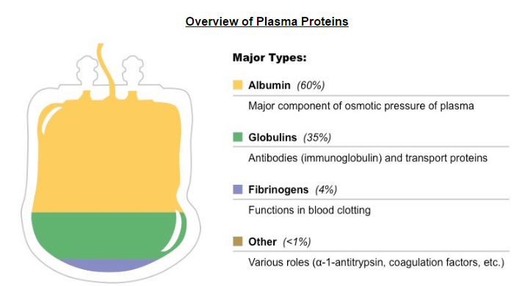
Production of plasma proteins
Endoplasmic reticulum and Golgi apparatus in hepatocytes produce plasma proteins.
The rough ER of hepatocytes within the liver produce 90% of the proteins the blood plasma, including such proteins as fibrinogen and albumin (carrier protein that binds to bilirubin).

Slide 11
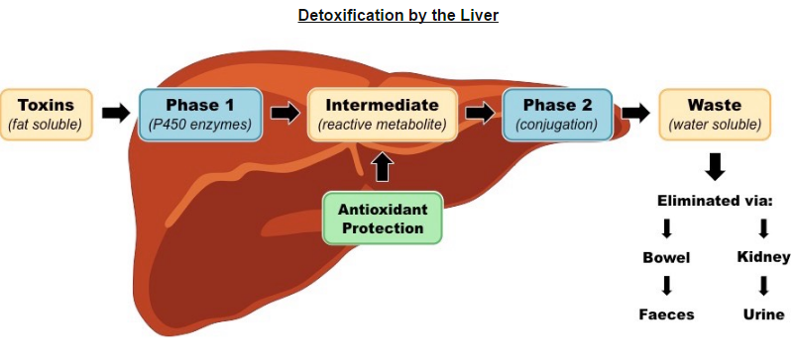
Detoxification by the liver
The liver removes toxins from the blood and detoxifies them.
Liver cells absorb toxic substances form the blood and convert them into non-toxic substances.
For example, alcohol is converted into a less toxic substance by enzyme ethanol dehydrogenase.
The liver converts ammonia into urea.
Hydrophobic → hydrophilic compounds

