Slide 1
D.5 Hormones and metabolism

Slide 2
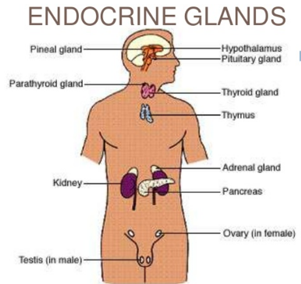
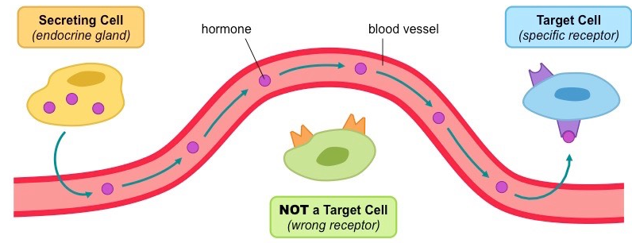
Endocrine glands
Endocrine glands secrete hormones directly into the bloodstream.
Endocrine glands are structures that secrete chemical messages, called hormones, directly into the blood..
These messages are transported to specific target cells.
Hormones can be steroids, proteins, glycoproteins, polypeptides, and others.

Slide 3
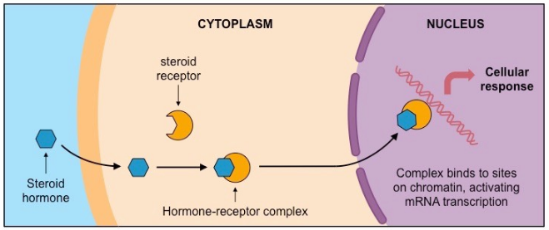
The mechanism of action of steroid hormones.
Steroid hormones bind to receptor proteins in the cytoplasm of the target cell to form a receptor- hormone complex.
Steroid hormones can cross directly through the plasma membrane and the nuclear membrane and bind to receptors.
Ex. Estrogen
The receptor-hormone complex then serves as a transcription factor, promoting or inhibiting the transcription of a certain gene.

Slide 4
Receptor-Hormone complex
The receptor-hormone complex promotes the transcription of specific genes.
Calciferol (steroid hormone) crosses the intestinal cell membrane and binds to a receptor within the nucleus.
The receptor-hormone complex effects expression of the calcium transport protein calbindin in the small intestine which then allows for the absorption of calcium from the intestine.

Slide 5
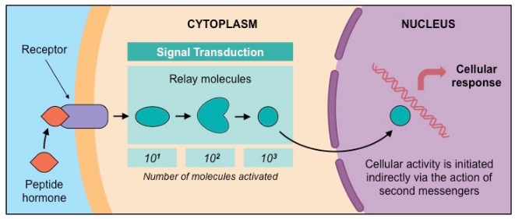
Mechanism of action of peptide hormones
Peptide hormones bind to receptors in the plasma membrane of the target cell.
Protein hormones are hydrophilic so they cannot pass through the membrane directly.
They bind to surface receptors that can trigger cascade reaction mediated by chemicals called second messengers.

Slide 6
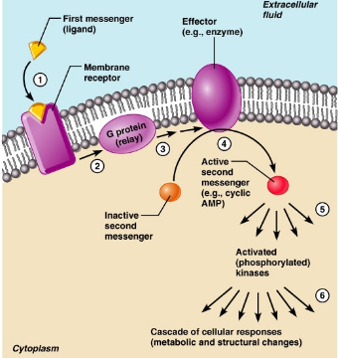
The role of second messengers
Binding of hormones to membrane receptors activates a cascade mediated by a second messenger inside the cell.
Second messengers are small water soluble molecules that can quickly spread throughout the cytoplasm and relay signals throughout the cells.

Slide 7
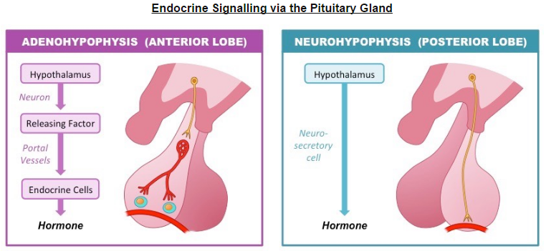
Pituitary hormones
Hormones secreted by the pituitary control growth, developmental changes, reproduction and homeostasis.
Anterior: synthesizes and secretes hormones that control growth, reproduction and homeostasis.
Posterior: secretes oxytocin and ADH, FSH and LH.

Slide 8
The role of the hypothalamus
The hypothalamus controls hormone secretion by the anterior and posterior lobes of the pituitary gland.
The role of the hypothalamus is to secrete releasing factors, which stimulate the secretion of the anterior pituitary glands' hormones.

