Slide 1
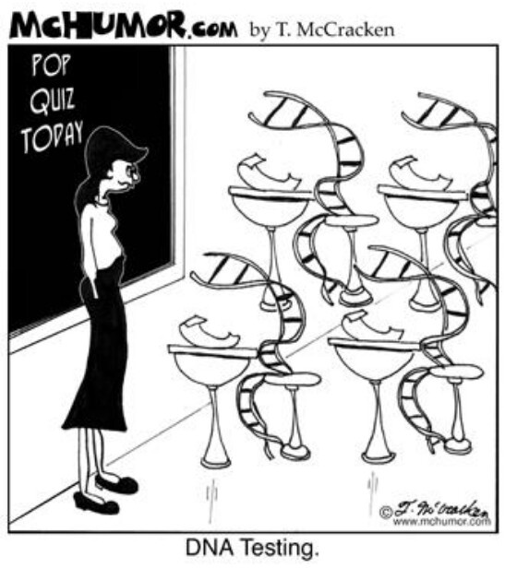
Forensic Science DNA Analysis

Slide 2
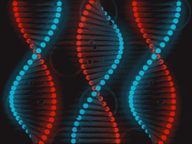
History of Biological Evidence in Forensics
DNA fingerprinting
Also known as DNA profiling
Used with a high degree of accuracy
Biological evidence is examined for the presence of inherited traits
Some forensics laboratory techniques were originally developed for other purposes.

Slide 3
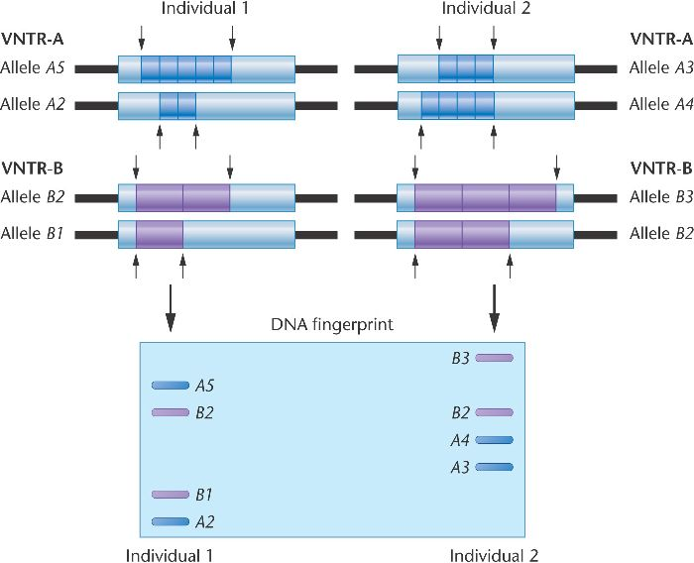
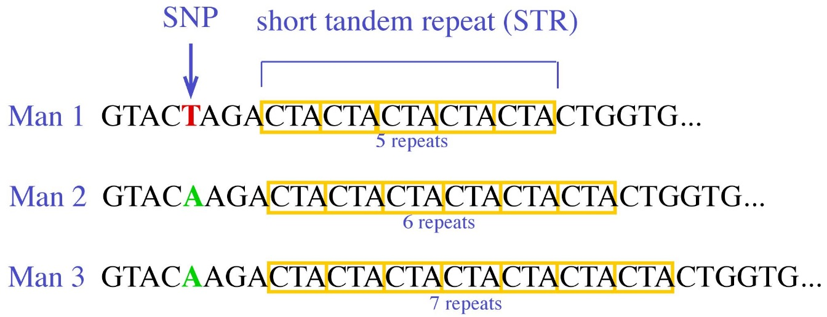
DNA Profile
Two types of repeating DNA sequences:
Variable Numbers of Tandem Repeats (VNTR)
The number of repeats varies from person to person
9 to 80 bases in length
Short Tandem Repeats (STR)
2 to 5 bases in length
Shorter lengths make STRs easier to use than VNTRs
VNTR and STR data are analyzed for
tissue matching
inheritance matching

Slide 4
DNA Profile Matching
Tissue Matching
Two samples that have the same band pattern are from the same person
Inheritance Matching
Each band in a child’s DNA fingerprint must be present in at least one parent

Slide 5
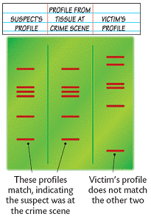
DNA Population Databases
Population genetics:
Study gene variations among groups of people
Look at probability of a person to have same form of a gene (an allele) as another person
Examples
Identifying the suspect in a crime
Identifying an alleged father in a paternity case

Slide 6
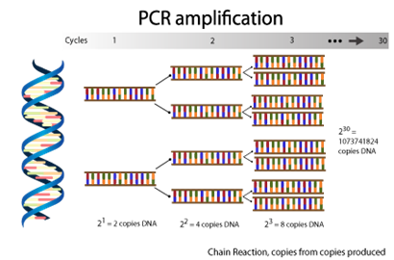
Sources of DNA
Biological evidence
Ex: saliva, blood, skin, hair, urine, etc.
May be class or individual evidence
May be only trace evidence (Small amount)
Polymerase chain reaction (PCR)
Makes many copies of DNA evidence
Amplifies the DNA “signal”

Slide 7
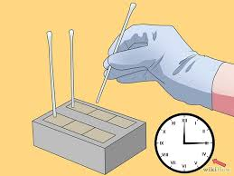
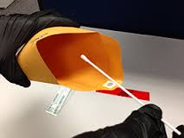
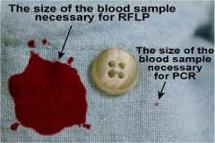
Collection and Preservation of DNA
Use disposable gloves and collection instruments
Avoid physical contact, talking, sneezing, and coughing in the evidence area
Air-dry evidence and put it into new paper bags or envelopes
Dry or freeze the evidence
Keep evidence cool and dry during transportation and storage

Slide 8
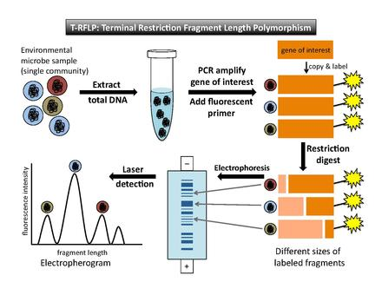
Preparing DNA Samples for Fingerprinting
Steps:
Extraction
Amplification
Gel Electrophoresis
Probes

Slide 9
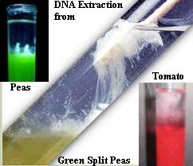
Preparing DNA Samples for Fingerprinting
Step 1: Extraction
Cells are isolated from biological evidence such as blood, saliva, urine, semen, and hair
The cells are broken to release the DNA from proteins and other cell components
The DNA can be extracted from the cell nucleus

Slide 10
Preparing DNA Samples for Fingerprinting
Step 2: Amplification via PCR
VNTR analyses—polymerase chain reaction (PCR) can be used to amplify the DNA that contains the VNTRs
STR profiles—restriction enzymes are unnecessary; PCR allows the amplification of the strands with STR sequences

Slide 11
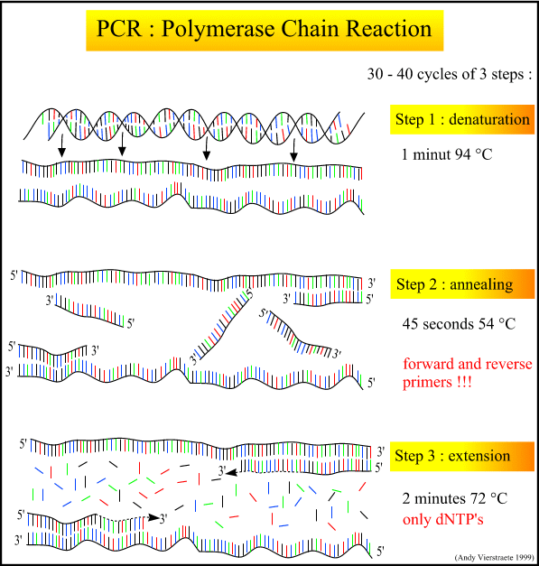
Amplification: PCR
Denaturation (heating): heat briefly to separate DNA strands
Annealing (cooling): cool to allow primers to bond with ends of DNA
Extension: DNA polymerase adds nucleotides to the end of each primer
Notes:
Figure 20.8 The polymerase chain reaction (PCR)

Slide 12
PCR song

Slide 13
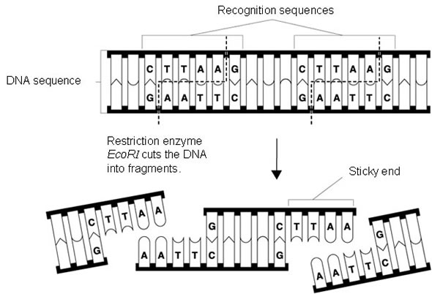
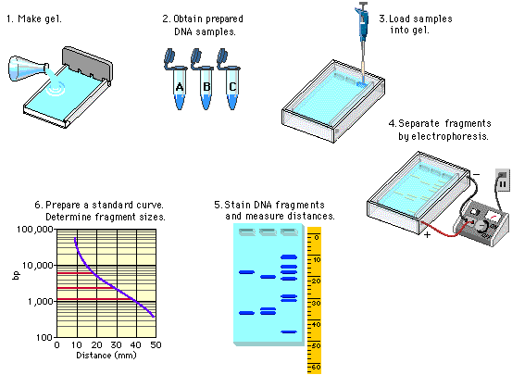
Preparing DNA Samples for Fingerprinting
Step 3: Electrophoresis
Bands of DNA are separated by size using electric current
DNA is mixed with special enzymes
Enzymes cut apart the DNA in specific places forming different sized fragments
DNA is separated within an agarose gel
An electric current is passed through the gel separating the fragments by size

Slide 14
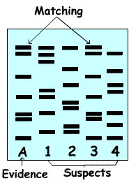
Gel Electrophoresis

Slide 15
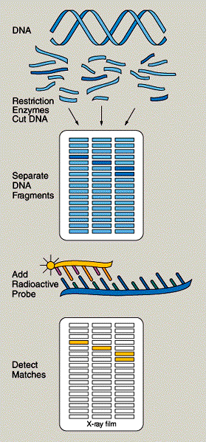
Probes
Step 4: DNA probes
Identify the unique sequences in a person’s DNA
Created of sequences of DNA bases complimentary to original DNA strand
Binds to complimentary bases in the strand
In most criminal cases, 6 to 8 probes are used

Slide 16
Analysis of DNA Fingerprints and Applications
Bands and widths are significant in
matching samples of DNA

Slide 17
Analysis of DNA Fingerprints and Applications
DNA fingerprinting can
Match crime scene DNA with a suspect
Determine maternity, paternity, or match to another relative
Eliminate a suspect
Free a falsely imprisoned individual
Identify human remains

Slide 18
. . . . . . . . . . . . . . Summary . . . .
DNA contains information needed to copy DNA (replication)
Allows even small amounts of evidence to be identified with a single person
DNA many repeated sequences that vary in number (non-coding regions = VNTRs and STRs)
Differences between individuals can be used to produce a DNA fingerprint for an individual

Slide 19
. . . . . . . . . . . . . . . . . Summary
Polymerase chain reaction (PCR) for DNA amplification has largely eliminated the problem of having only tiny samples/evidence
DNA evidence must be collected carefully to avoid contamination with other DNA
DNA analysis involves extraction of DNA, PCR, gel electrophoresis, and visualization (probes or staining)
DNA profiles are kept by police agencies in electronic databases (CODIS)

Slide 20
