Slide 1
DNA Replication

Slide 2
WHY does DNA replicate itself?
For the formation of gametes.
These are sex cells that help with reproduction.
Divide through the process of Meiosis.
For making new cells through MITOSIS.
Also know as somatic, or body cells.
Helps with growth and maintenance.

Slide 3
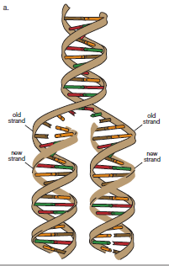
Recap: What is Replication?
When DNA in cells is copied during interphase.

Slide 4
Where is DNA contained inside of a cell?

Slide 5
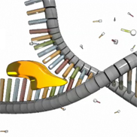
What are the steps of replication?
The DNA strands need to separate!
Is done with the help of HELICASE
Enzyme that breaks Hydrogen Bonds between bases!

Slide 6
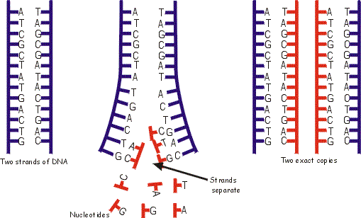
What are the steps of replication?
2. Each strand then serves as a template to be copied.

Slide 7
What are the steps of replication?
Nucleotides are added according to base pair rules with help from DNA Polymerase.
Adds nucleotides to create new strand
creates a hydrogen bond between the base on the template strand and the base on the new strand.

Slide 9
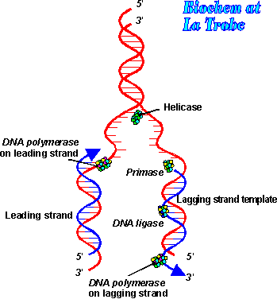
What is the end result?
Two new copies of DNA!
One strand is from the original DNA
The other is the new DNA.

Slide 10
Transcription

Slide 11
What is transcription? DNA→RNA
When DNA is used to make mRNA.
Occurs in the nucleus!
Uracil replaces thymine!
Very similar to DNA replication but RNA is the end result!

Slide 12
What is the role of RNA?
To serve as the MESSENGER between DNA and the ribosomes.
DNA: ACG CAC TAG
RNA:

Slide 14
Recap: RNA

Slide 15
Agenda: 1/24
Review Translation
Protein Synthesis Activity
Gene, what gene?

Slide 16
Translation

Slide 17
What is Translation? RNA→ Protein
When RNA from transcription is used to make protein.
Happens at the ribosomes in the cytoplasm.
mRNA is “read” by ribosomes is sets of 3 nucleotides.
These are called CODONS
Each codon codes for a specific amino acid.
Amino acids build protein.

Slide 18
How do we know which amino acids to use?

Slide 19
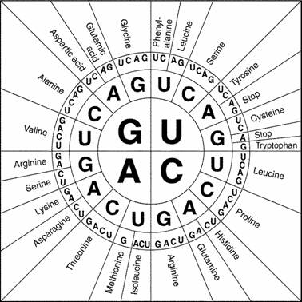
How do we know which amino acids to use?
DNA: ACA GTA CAT
RNA:
Amino:

Slide 20
How do we know which amino acids to use?
DNA: AGC CGA TAG
RNA:
Amino:

Slide 21
How do we know which amino acids to use?
mRNA tells the ribosome which amino acid is needed.
tRNA then brings the amino acid to the ribosomes according the codon on mRNA.
tRNA=transfer RNA
Transfers the correct amino acid with use of matching anticodons.

Slide 22
TRNA Vs. mRNA

Slide 23
TRNA Vs. mRNA

Slide 24
Putting it all together

Slide 25
START CODON!!!
AUG→MET

Slide 26
Genetic Coding
Each of you need to decode at least 5 DNA sequences.
This is individual!
Each person at your group needs to complete different sequences…meaning no two people at a table should have the same sequence.
Treat the table you are sitting at now as the nucleus.
The lab tables with the correct color is the cytoplasm!

Slide 27
Mutations

Slide 28
Replication, Transcription/Translation Quiz
Take a few minutes to look over your notes, any questions?
While you are looking over your notes I will be coming around to take a look at your Gene, What gene? Assignment. Do not turn this in yet…we will go over part of it as a class today!

Slide 29
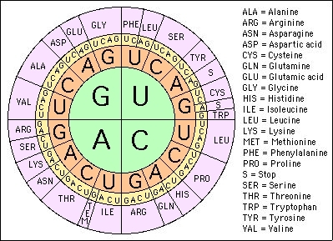
Replication, Transcription/Translation Quiz

Slide 30
Mutations
Two different types of mutations:
Gene
Change in the sequence of nucleotides in DNA.
Can happen in somatic cells as well as gametes.
Chromosomal
More on this next unit!

Slide 31
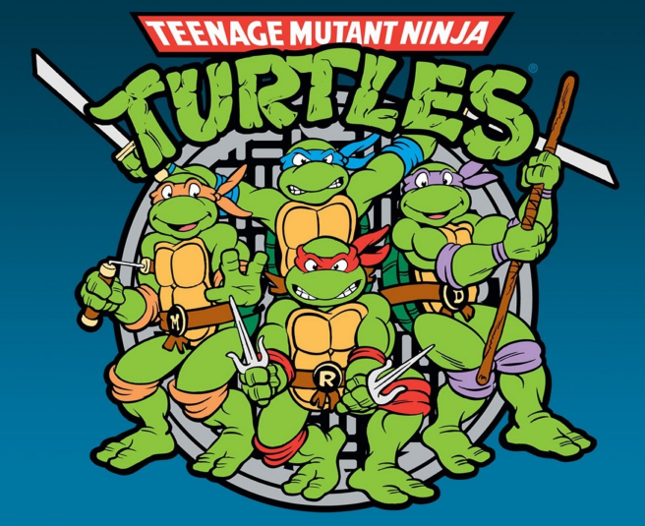
What are gene mutations?
Change in the nucleotide sequence of a gene.
May only involve a single nucleotide.
May be a result of errors in DNA replication, exposure to chemicals, etc.

Slide 32
What are the types of gene mutations?
Types Gene Mutations:
Point mutations
Change in a single nucleotide.
Example:
Substitution mutations
Frameshift
Inserting or deleting one or more nucleotides.
Example:
Insertions
Deletions

Slide 33
Point mutations
When one base is changed in the DNA sequence.
Can be harmful, beneficial or silent.

Slide 34
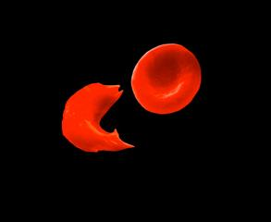
Diseases caused by point mutations:
Sickle Cell Anemia.
Caused by substitution mutation.
Changes the shape of red blood cell.
Hemoglobin is misshaped.
Hemoglobin is the protein that your binds to oxygen in your blood.

Slide 35
Frameshift Mutations
Caused by inserting or deleting one or more nucleotides in DNA.
Changes the “reading frame” of the DNA.
Proteins built incorrectly.
Can be harmful!

Slide 36
Frameshift Mutations
Original:
The fat cat ate the wee rat.
Frame Shift (“a” added):
The fat caa tet hew eer at.

Slide 38
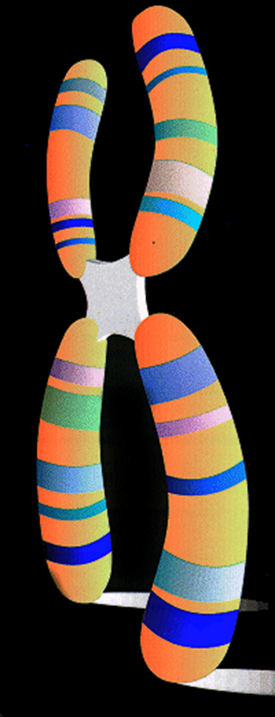
What are chromosomal mutations?
More on this next unit!
These usually deal with changing the structure or number of chromosomes.

Slide 39
Are mutations Helpful or harmful?
Mutations happen ALL THE TIME!
Most don’t have any effect on the organism.
Mutations cause genetic variation, which is extremely beneficial!
Variation in traits are all thanks to mutations.
Many are repaired by enzymes before they have any negative effect.

