Slide 1
Forensic DNA Analysis
DNA Replication

Slide 2
The Double-Helix Model
Explains Chargaff’s rule of base pairing (how strands DNA strands held together)
The nucleotides can be joined together in any order
So, any sequence of bases is possible

Slide 3
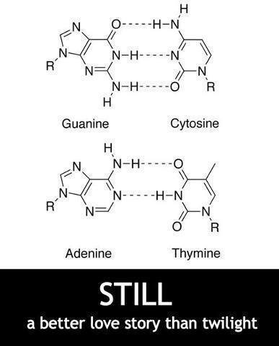

Slide 4
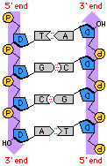
Antiparallel Strands
In the double-helix model, the two strands of DNA are “antiparallel”—they run in opposite directions
It allows each strand to carry a
sequence of nucleotides
Like letters in a four-letter alphabet

Slide 5
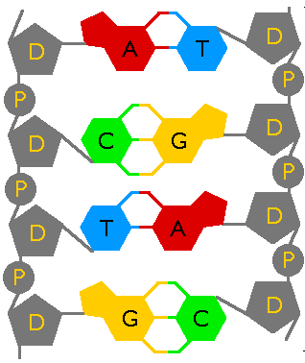
Hydrogen Bonding
Hydrogen bonds between bases hold the two strands together
G-C has 3
A-T has 2
Hydrogen bonds can be broken easily
Two strands can separate to be copied

Slide 6
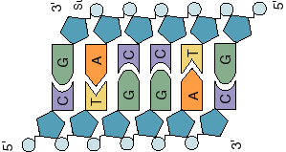
Copying the Code
Each strand of DNA has all the information needed to make the other half: through base pairing
Because each strand can be used to make the other strand, the strands are said to be complementary.

Slide 7
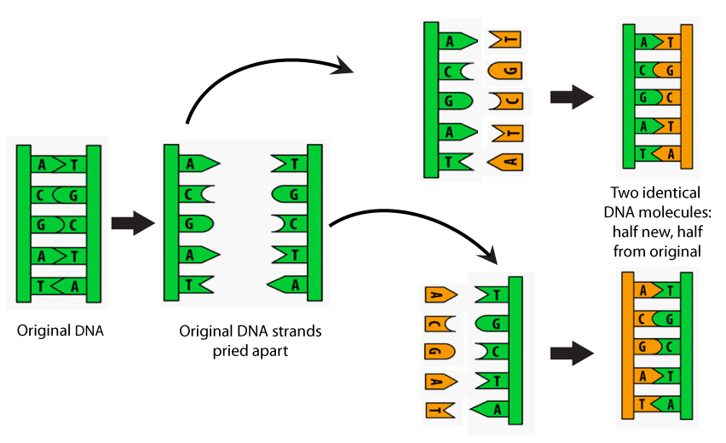
The replication process
Before a cell divides, it duplicates its DNA
Replication
This process makes sure that each cell has the same complete set of DNA molecules

Slide 8
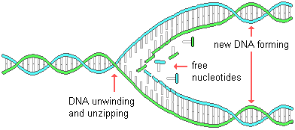
The Replication Process
During replication:
DNA molecule separates into two strands
Then produces two new complementary strands
Each strand of the double helix of DNA serves as a template, or model, for the new strand

Slide 9
The Replication Process
The result of replication is two DNA molecules identical to each other and to the original molecule.
Each DNA molecule resulting from replication has
one original strand 2. one new strand

Slide 10
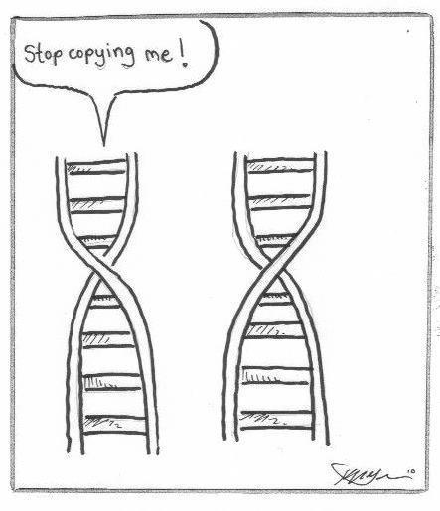

Slide 11
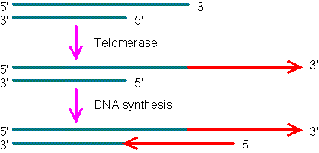
Telomeres
Tips of chromosomes called telomeres
DNA is often lost from telomeres each time a chromosome replicates
An enzyme called telomerase compensates for this problem by adding short DNA sequences to telomeres
Lengthening the chromosomes slightly

Slide 12
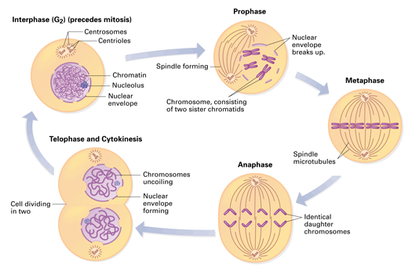
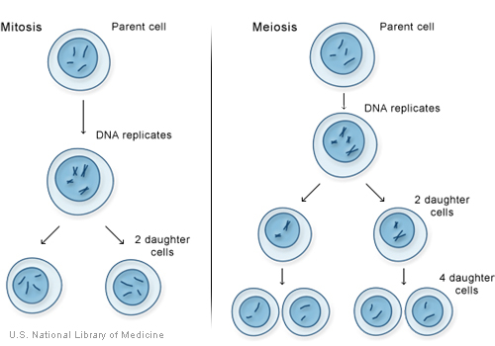
Eukaryotic DNA Replication
The DNA copies separate from each other in anaphase of mitosis, producing two cells, each with a complete set of genes coded in DNA.

Slide 13
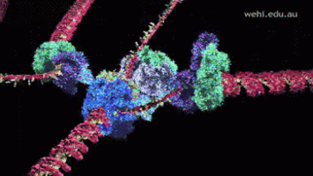

Slide 14
GTCA Song…
https://www.youtube.com/watch?v=ID6KY1QBR5s

