Slide 1
Grab a packet of notes!!

Slide 2
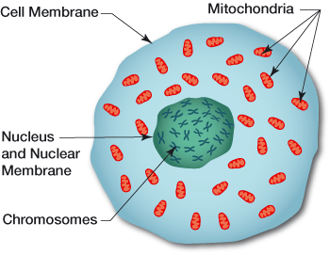
Forensic DNA Analysis
History and Structure of DNA

Slide 3
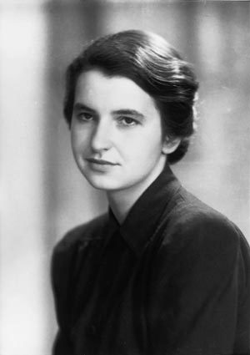
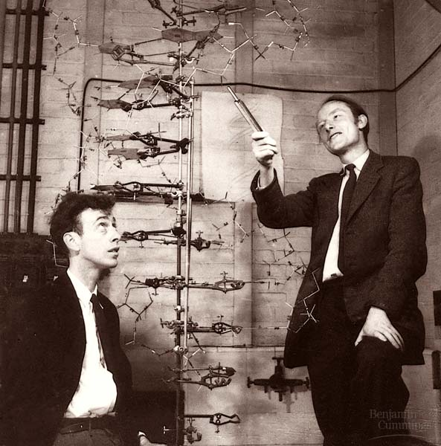
What is DNA
DNA stands for deoxyribonucleic acid and contains genetic information.
It is found on chromosomes located in the nucleus of our cells.

Slide 4
Historical Information
1953—James Watson, Francis Crick and Rosalind Franklin discover the configuration of the DNA molecule
1980—Ray White describes first polymorphic RFLP marker
1985—Alec Jeffreys isolates DNA markers and calls them DNA fingerprints
1985—Kary Mullis develops PCR testing
1988—FBI starts DNA casework
1991—First STR paper
1998—FBI launches CODIS (Federal DNA database)
Notes:
Restriction fragment length polymorphism

Slide 5
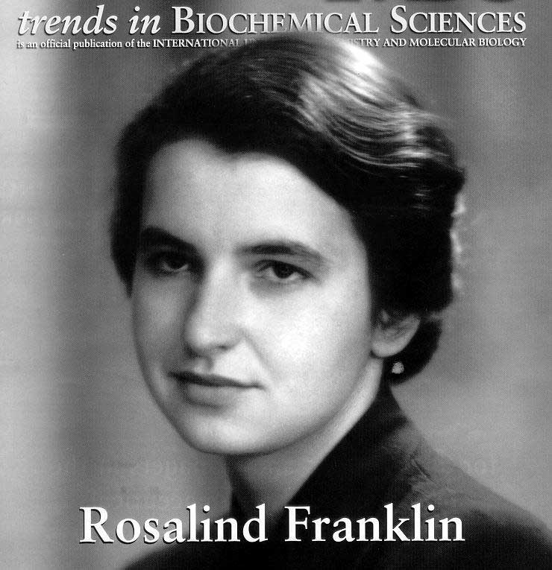
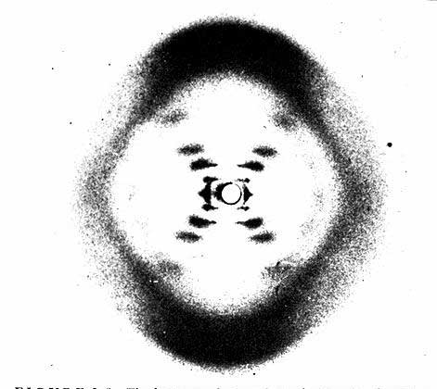
People of Historical Significance
James Watson, Francis Crick, and Maurice Wilkins jointly received the Nobel Prize in 1962 for their determination of the structure of DNA.
Interesting fact: Rosalind Franklin had as much to do with the discovery as the three men with her work on X-ray crystallography.
She died of cancer and could not be honored for her work.

Slide 6
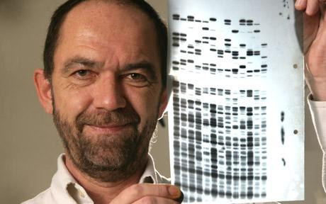
People of Historical Significance
Sir Alec Jeffreys:
Credited with DNA profiling using RFLP
Restricting fragment length polymorphisms “whew!”
September 1984, Jeffreys saw his first series of blots on an X ray
Technique first used in forensics in 1985,
Asked by police to confirm rape confession of 17-year-old Richard Buckland
Who was denying rape of another woman
Colin Pitchfork →
Notes:
a local 17-year-old with learning disabilities who worked at Carlton Hayes psychiatric hospital, had been spotted near Dawn Ashworth’s murder scene and knew unreleased details about the body. In 1986, he confessed to Dawn Ashworth’s murder but not Lynda Mann’s.

Slide 7
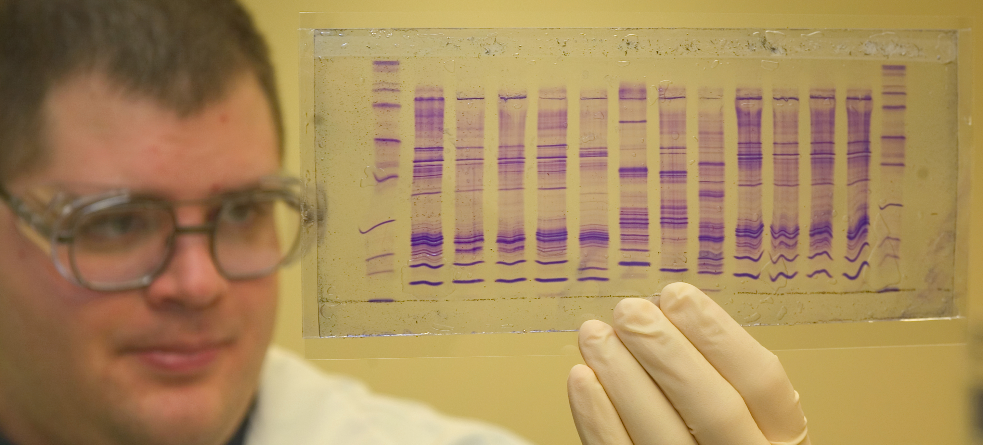
Mid-1980s: The Colin Pitchfork Case
Two young women raped and murdered in Narborough, England
Comparison of DNA from Buckland and DNA taken from the victims eliminated him as a suspect
5,000 local men are asked to provide blood/saliva samples
Jeffreys used samples from other suspects to later help convict Colin Pitchfork
Whose DNA did match the samples from the victims
1st exoneration and conviction using DNA evidence

Slide 8
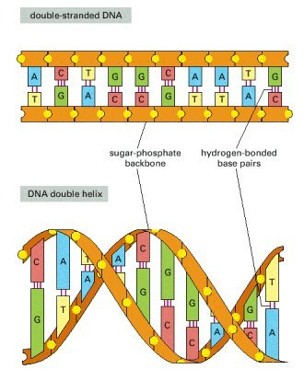
DNA General Information
Double helix—two coiled DNA strands
Composed of nucleotides (a single unit) containing:
Sugar molecule (deoxyribose),
Phosphate group
Nitrogen-containing base (A, T, G, or C)
In humans, the order of these bases is 99.9 percent the same
The sides/backbone are made up of sugar and phosphate molecules

Slide 9
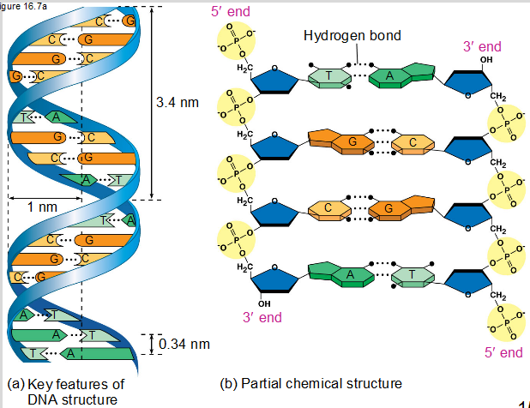

Slide 10
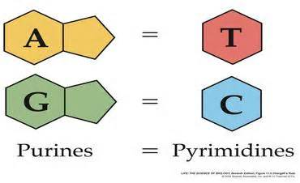
DNA General Information
The rungs that form the middle of the molecule are made up of pairs of nitrogen bases.
Four bases in DNA:
Adenine (A)
Cytosine (C)
Guanine (G)
Thymine (T)
Chargaff’s Rule: Bases always pair A to T and G to C.
If a sample has 20% Adenine, how much thymine is present?
Guanine?
Notes:
T= 20%
G= 30%

Slide 11
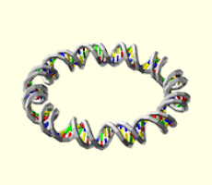
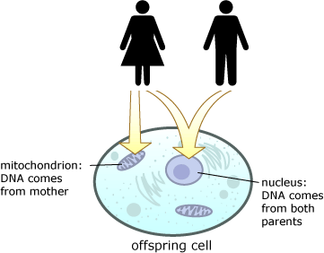
Types of DNA
Nuclear
Mitochondrial
Found in nucleus
Has 23 pairs of chromosomes inherited from both parents = 46 total
Each cell contains only one nucleus
Found in the cytoplasm
Is inherited only from mother
Each cell contains hundreds to thousands of mitochondria
Can be found in skeletal remains
- Nuclear DNA is present in the head of the sperm.
- Mitochondrial DNA is present in the tail.
- At conception, the head of the sperm enters the egg and unites with the nucleus.
- The tail falls off, losing the father’s mitochondrial DNA.

Slide 12
Mitochondrial DNA
Analysis of mtDNA is more:
Rigorous
Time-consuming
Costly than nucleic testing of DNA
mtDNA is constructed in a circle or loop
Thirty-seven genes are involved in mitochondrial energy generation
Is used when nuclear DNA typing is not possible

Slide 13
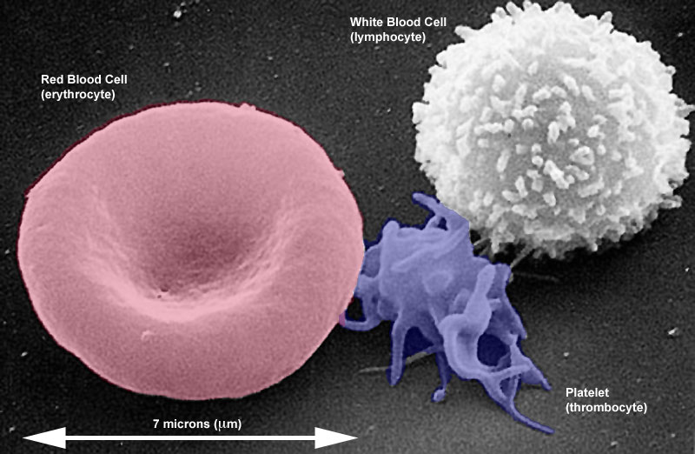
Where is DNA Found?
Genes are portions of DNA that code for specific proteins
DNA is found in all body cells that have a nucleus:
White blood cells, semen, saliva, urine, hair roots, teeth, bone, tissue, etc.
Most abundant in cheek cells
Red blood cells have no nuclei
Therefore, no nuclear DNA
DNA obtained from blood
comes from white blood cells

Slide 14
What Factors Affect DNA Evidence
Several factors can affect DNA left at a crime scene, such as environmental factors:
Heat
Sunlight
Moisture
Bacteria
Mold
Not all DNA evidence will result in a usable DNA profile
DNA testing cannot identify when the suspect was at the crime scene or for how long

Slide 15
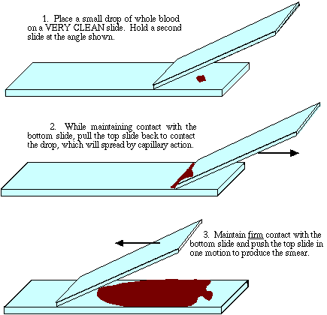
DNA Collection & Comparison
DNA is collected at crime scenes in a variety of ways using tools such as:
Luminol and/or blood collection kits (for sample collection of suspects or living victims)
Scalpels
Tweezers
Scissors
Sterile cloth squares
UV light
Smear slides

Slide 16
DNA Collection & Comparison
How is blood collected?
Blood on Clothing:
Investigators submit whole pieces of clothing
Or may use sterile cloth square and small amount of distilled water
Dried blood on furniture:
Investigators send the whole object to the lab
Dried blood on a wall, tub or object too big to move to lab:
Investigators scrape blood sample into sterile container for further analysis

Slide 17
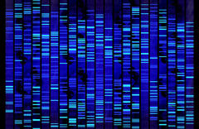
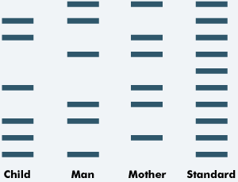
DNA Typing
Method where DNA is converted into a series of bands that distinguish each individual (unique pattern)
Only 0.1% of DNA (about three million bases) differs from one person to the next
Scientists use these regions to generate a DNA profile of an individual

Slide 18
Non-coding Regions
3% of the human DNA code for stuff we need/use
97% is non-coding and is repetitive, repeating the same sequence over and over
50% of the human genome has interspersed repetitive sequences

Slide 19
Uses of DNA Profiling
Identifying potential suspects
Exonerating individuals (finding them not guilty/set free)
Identifying crime scenes and victims
Burned bodies, decomposed bodies, etc.
Establishing paternity and proving family relations
“You are NOT the father!”
Matching organ donors
Identifications of John Doe or Jane Doe
Studying evolution and ancestry
Through nuclear and mitochondrial DNAs
Studying inherited disorders

