Slide 1
Graphing
Using DR TAILS

Slide 2
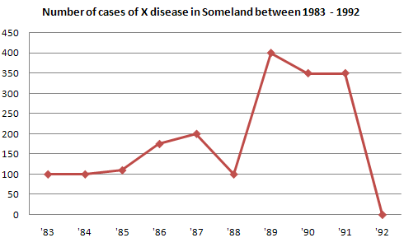
What is a graph?
A graph communicates in picture form the data collected in an experiment.

Slide 3
Why do you need to learn about graphing?
You will be graphing the data you collect from experiments.
To interpret your data
Need to communicate your results with the class.

Slide 4
DR TAILS
Data
All data should be plotted accurately.
With large sets of data, count the number of points and make sure you have the correct total.
Be sure not to mix up x and y axes.
Use small points that will make it easy to see where the point has been placed.

Slide 5
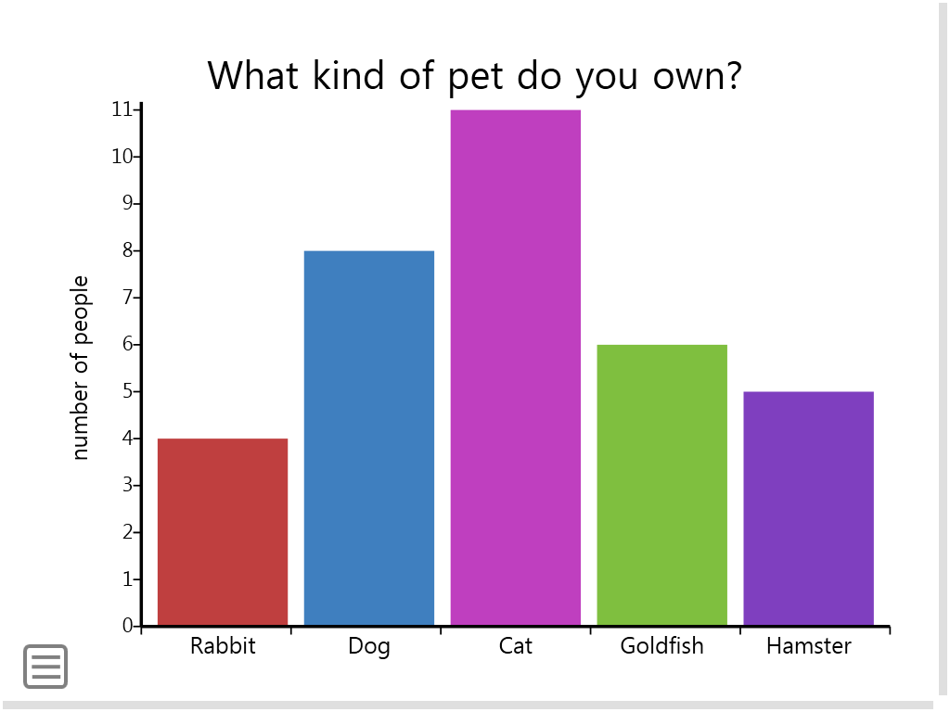
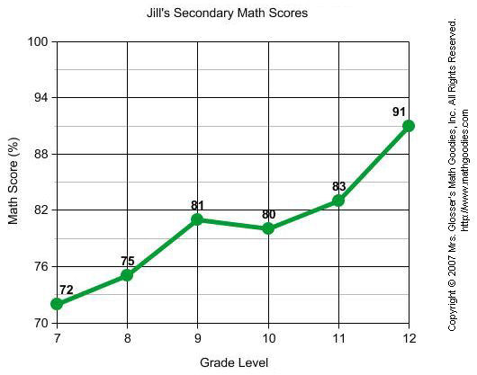
Bar vs. Line graphs ….which should I use?
Notes:
Bar: discrete data (categorical)
Line: continous

Slide 6
DR TAILS
Ruler
A ruler should be used to make straight axes
Graph should include line of best fit
*Constructing graphs in excel is encouraged.

Slide 7
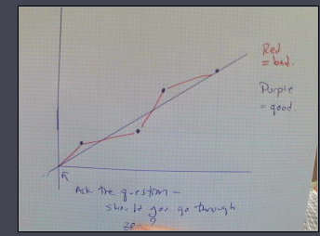
Line of best fit, must go through (0,0).
Half the points above, half the points below the line.

Slide 8
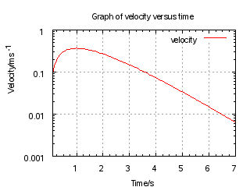
DR TAILS
Title: Your title should follow this: The effect of Manipulated Variable vs. Responding Variable.
Ex. The effect of wing length vs Time of descent.

Slide 9
DR TAILS
Axis
Remember DRY MIX
The Dependent (or Responding variable) goes on the Y axis
The Manipulated (or Independent variable) goes on the X axis.

Slide 10
DR TAILS
Increments
Choose a scale that will fit all of your data on the page
Start from the origin, with equal numbering and spacing from there.
Make sure that you choose increments that will have you using as much of your graph.
Questions to ask yourself:
How many squares do you have to work with?
How much data do you have to graph?

Slide 11
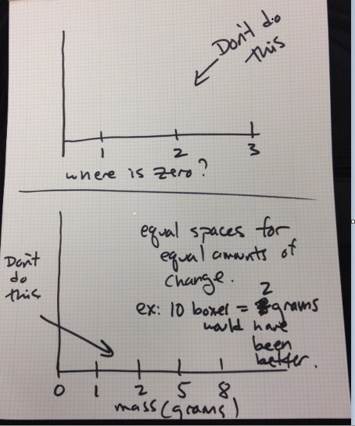
Bad examples – make sure your origin is at zero, and mark at equal increments (unlike the bottom graph)

Slide 12
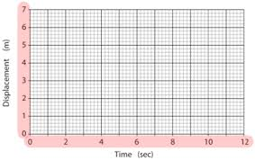
A good choice of increments
With the boxes available, 12 seconds fit into this space well by choosing 10 boxes = 2 seconds.
Try different scales, trying to fill up the space you have while still having nice even increments
For plotting.

Slide 13
DR TAILS
Labels – on each axis, you need labels with units.
Examples: mass (grams), Volume (mL), length (m)
The variable (mass, volume, length) is the label. The way you measure it (grams, mL, ) is the units.

Slide 14
DR TAILS
Size:
Your graph must take up at least half of the available space.
For a graph on a full page of paper, that means it should be over a half of page.
You will not earn this point if you choose increments that squish your data into a very small part of your graph.

Slide 15
Statement
Statement: You must include a statement that includes WHAT YOU SEE (shape or slope of the graph), and WHAT IT MEANS (here you need to talk about the variables on the graph).
Example: This graph is a straight line, so the slope does not change. Because the slope is constant, the speed (position over time) is constant.
This will be the most challenging part of the score, and will be something we should discuss for each graph.

