Slide 1
Evidence Collection and Chain of Custody

Slide 2
Once evidence is identified…
It must be packaged, sealed, and labeled properly.
liquids and arson remains=airtight, unbreakable containers
Moist biological evidence=breathable container until dried out, then paper bindle and plastic or paper container.
Evidence Labels must be filled out properly!

Slide 3
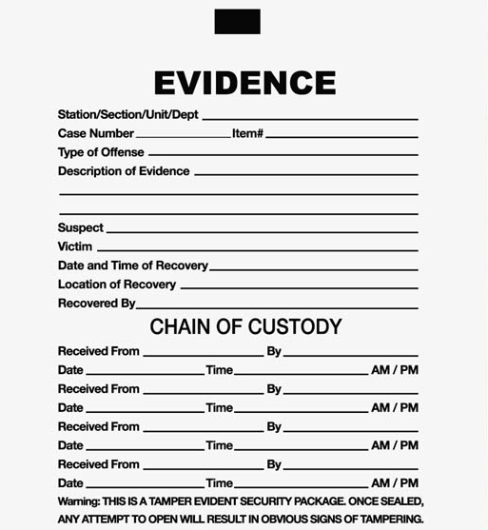

Slide 4
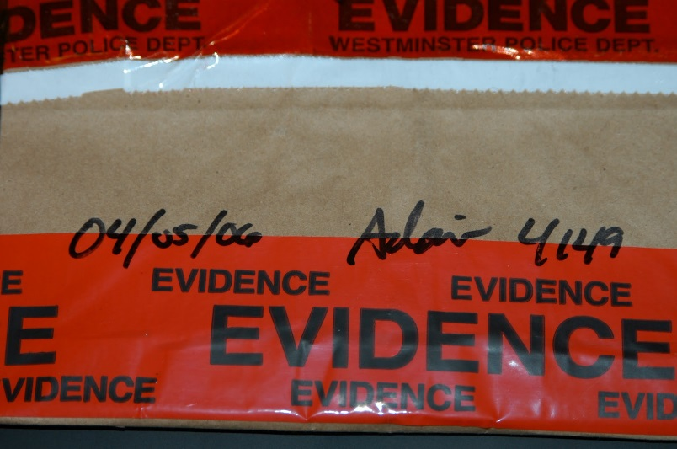
Chain of custody/posession
The final container for the evidence is a collection bag.
Once labelled, the container is sealed and the collectors signature is written across the sealed edge.
When the evidence is given to the next person responsible for its care, who takes it to the lab and signs it over to a technician.
Each time the evidence changes hands, the chain of custody must be signed to ensure proper handling of evidence

Slide 5
Evidence Analysis

Slide 6
Types of Analysis
Comparison
Visual
Microscopic
Chemical

Slide 7
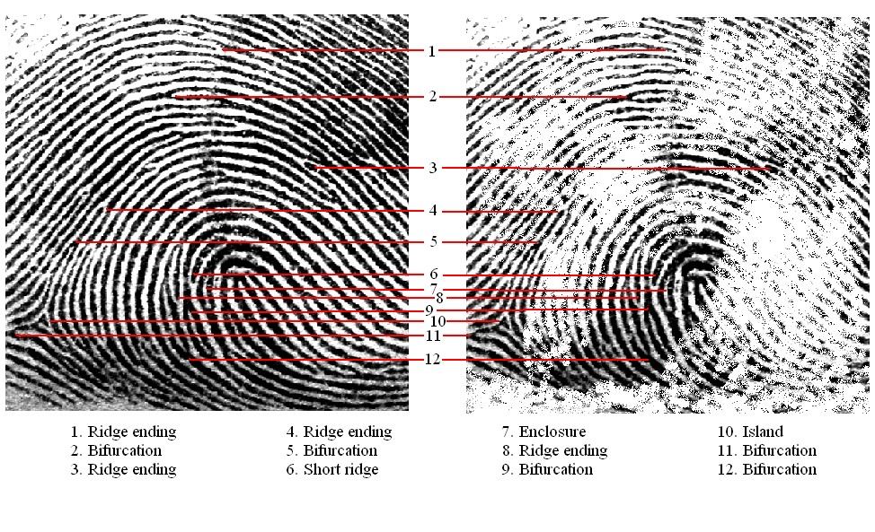
Comparison
Most types of evidence require a control with which to be compared
bsapp.com

Slide 8
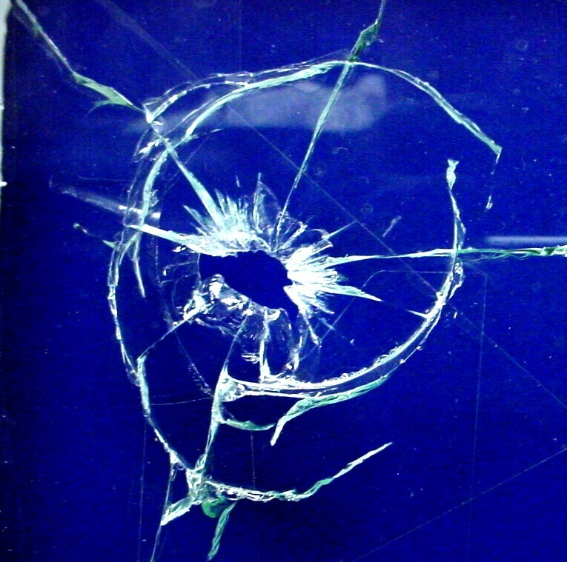
Visual Analysis
Evidence utilized through unaided observation
bsapp.com

Slide 9
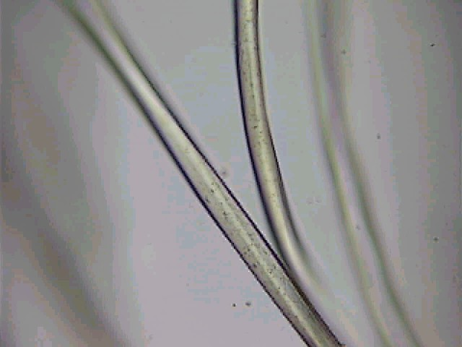
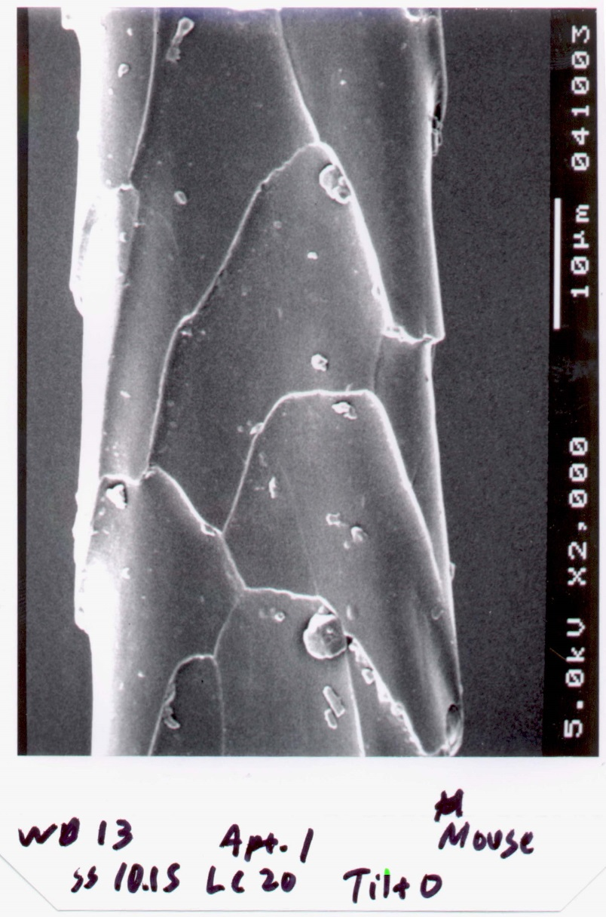
Microscopic Analysis
Evidence observed with the use of some type of microscope
bsapp.com

Slide 10
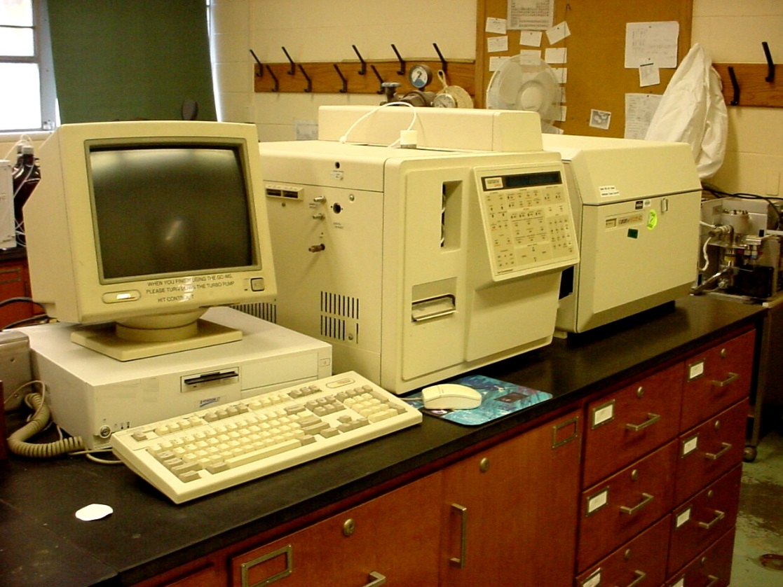
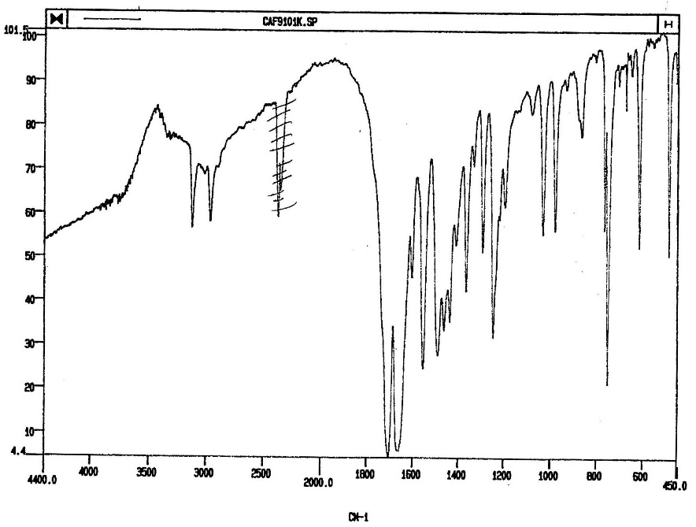
Chemical Analysis
Evidence subjected to any type of chemical procedure
bsapp.com

Slide 11
Evidence Collection Guidelines
As a squad, create guidelines for collecting the following types of evidence at a crime scene
**Cite sources!
Blood Stains Hair Fibers and Threads Glass Paint Flammable Liquids Firearms Evidence Tool Marks Controlled Substances and Medicinal Preparations Questioned Documents Latent Fingerprints

