Slide 1
A Study of Fibers and Textiles

Slide 2
How Forensic Scientists Use Fibers
Fibers are used in forensic science to create a link between crime and suspect
Through normal activities
We shed fibers
We picked up fibers
Very small fibers are classified as trace evidence
Fiber evaluation can show
Type of fiber
Color
Possibility of violence
Location of suspects
Point of origin

Slide 3
Sampling and Testing
Shedding—common form of fiber transfer
Microscopes reveal characteristic shapes and markings
Infrared spectroscopy reveals chemical structures to differentiate similar fibers
Destructive Testing Methods
Burning fibers
Dissolving fibers in various liquids

Slide 4
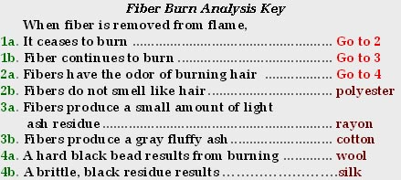
Sampling and Testing
Compare fibers found on different suspects with those found at the crime scene

Slide 5
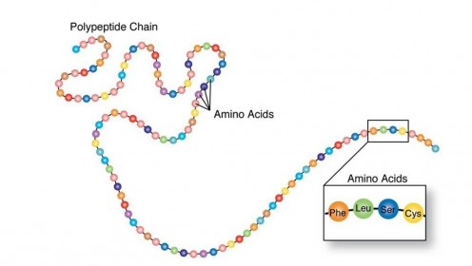
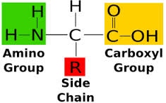
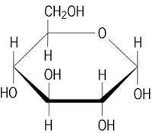
Macromolecules
4 Macromolecules:
Lipids (does not form polymers)
Nucleic Acids
Monomers: Nucleotides
Polymer: DNA/RNA
Function: Hereditary information
Carbohydrates
Monomers: Single sugars/monosaccharides
Polymer: polysaccharides
Animals: glycogen (energy storage)
Plants: Starch (energy storage) and Cellulose (structural)
Function: Energy storage/cell-cell recognition
Proteins
Monomer: amino acids
Polymer: polypeptide chain (protein)
Function: structural support, storage, transport, cellular communications, movement, and defense against foreign substances, Hair is made of protein

Slide 6
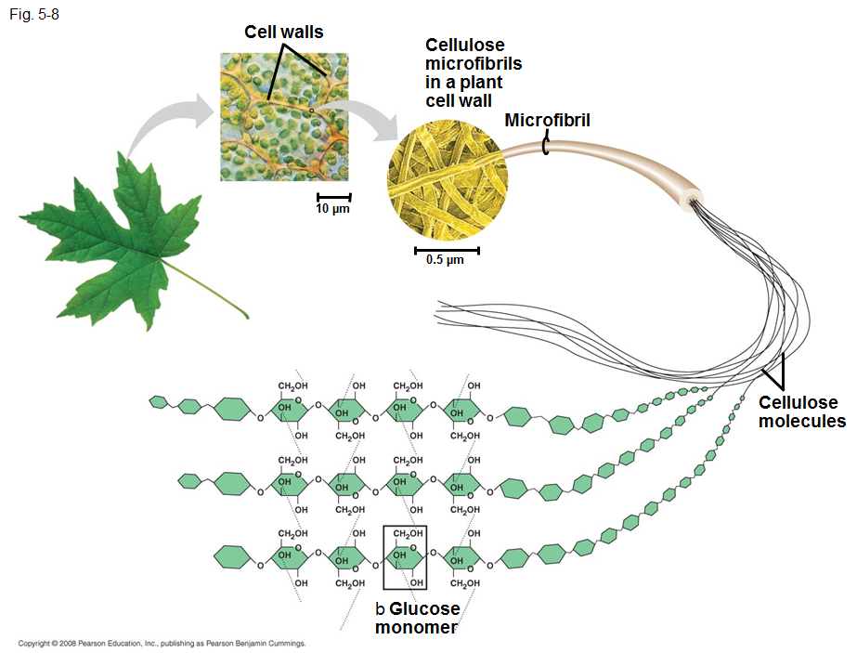
Polymerization
Macromolecules form long chains (polymers) from single building blocks (monomers)
Carbohydrates (cellulose in plants) and proteins (polypeptides from animals) are used to make fibers and textiles

Slide 7
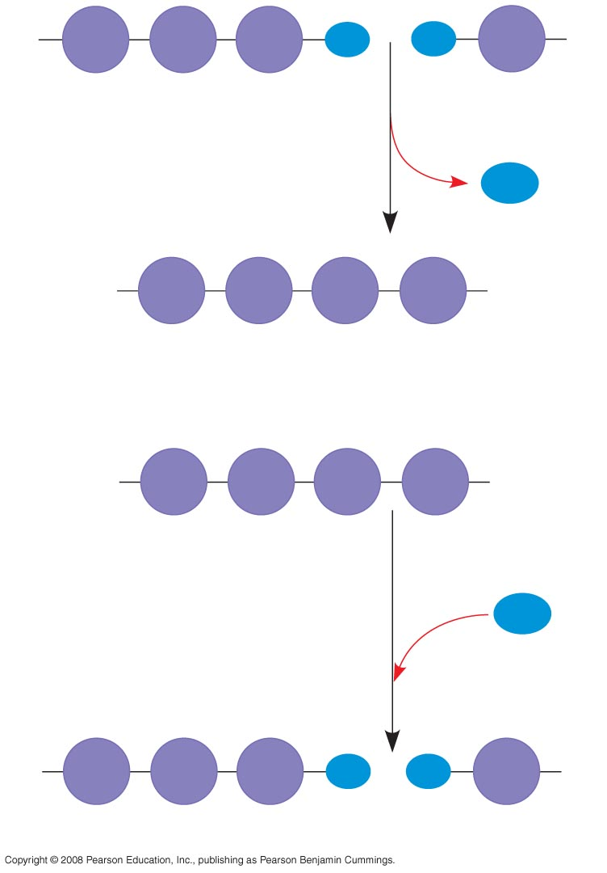
Fig. 5-2
HO
1
2
3
H
HO
H
Condensation/dehydration reaction=two monomers bond together through the loss of a water molecule
Short polymer
Unlinked monomer
Dehydration removes a water
molecule, forming a new bond
H₂O
HO
1
2
3
4
H
Longer polymer
Hydrolysis= addition of water to separate a polymer
(reverse of dehydration reaction)
(a) Dehydration reaction in the synthesis of a polymer
Enzymes= proteins that speed up the reaction without being consumed in the reaction
HO
1
2
3
4
H
Hydrolysis adds a water
molecule, breaking a bond
H₂O
HO
1
2
3
H
HO
H
(b) Hydrolysis of a polymer
Notes:
Figure 5.2 The synthesis and breakdown of polymers

Slide 8
Fiber Classification —Natural Fibers: Animal
Characteristics:
Made of proteins
Insulating properties
Resists wrinkling
Examples:
Wool and cashmere from sheep
Mohair from goats
Angora from rabbits
Hair from alpacas, llamas, and camels
Silk from caterpillar cocoons (longer fiber does not shed easily)
woven wool textile

Slide 9
Fiber Classification —Natural Fibers: Plant
Characteristics:
Made of cellulose
Absorb water
Insoluble in water
Very resistant to damage from harsh chemicals
Dissolvable only by strong acids
Becomes brittle over time
Plant fibers (examples):
Cotton—most common textile plant fiber (picture)
Coir from coconuts is durable
Hemp, jute, and flax from stems grow in bundles
Manila and sisal from leaves deteriorate more quickly

Slide 10
Fiber Classification —Natural Fibers: Mineral
Characteristics:
Resistant to chemical attack
Insulating qualities
Heat resistant
Non flammable
Doesn’t deteriorate in normal usage
Examples:
Fiberglass—a fibrous form of glass
Asbestos—a crystalline structure

Slide 11
Fiber Classification —Synthetic Fibers
50% of fabrics are artificially produced
Characteristics:
Vinyl polymers
Resistant to biological and chemical degradation
Examples:
Rayon
Acetate
Nylon
Acrylic
Polyester

Slide 12
Fiber Classification —Synthetic Cellulose Fibers
Regenerated Fibers (derived from cellulose): Produced by processing various natural polymers
Rayon
Most common in this group
Imitates natural fibers, but stronger
Celenese®
Cellulose chemically combined with acetate
Found in many carpets
Polyamide nylon
Cellulose combined with three acetate units
Breathable and lightweight
Used in performance clothing

Slide 13
Fiber Classification —Synthetic Polymer Fibers
Synthetic Polymer Fibers
Characteristics:
Petroleum base
Very different from other fibers
Monomers join to form polymers
Fibers are spun together into yarns
No internal structures
Uniform diameters

Slide 14
Fiber Classification —Synthetic Polymer Fibers
Polyester
“Polar fleece”
Wrinkle-resistant
Not easily broken down by light or concentrated acid
Added to natural fibers for strength
Nylon
Easily broken down by light and concentrated acid
Otherwise similar to polyester
spandex nylon

Slide 15
Fiber Classification —Synthetic Polymer Fibers
Acrylic
Inexpensive
Tends to “ball” easily
Substitute for artificial wool or fur
Olefins
High performance
Quick drying
Resistant to wear

Slide 16
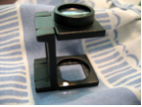
Comparison of Natural and Synthetic Fibers
Visual Diagnostics of Some Common Textile Fibers
under Magnification

Slide 17
Yarns, fabrics, and textiles
Yarns—fibers (of any length, thick or thin, loose or tight) twisted or spun together
Blending fibers meets different needs (e.g., resistance to wrinkling)
Fibers are woven into fabrics or textiles
Threads are arranged side by side (the warp)
More threads (the weft) are woven back and forth crosswise through the warp

Slide 18
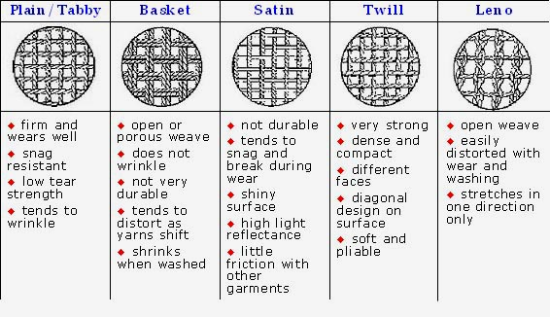
Weave Patterns

Slide 19
. . . . . . . . . . . . . Summary . . . .
Fibers are a form of class evidence.
Fibers are a form of trace evidence.
Fibers are spun into yarns having specific characteristics.
Yarns are woven, with different patterns, into clothing or textiles.
Fiber evidence is gathered using different techniques.

Slide 20
. . . . . . . . . . . . . . . . . Summary
Fibers are analyzed using burn tests, tests for solubility in different solutions, polarized light microscopy, or infrared spectroscopy.
Fibers are classified as natural or synthetic.
Natural fiber sources include:
Animal hair
Plant seeds, fruit, stems, or leaves
Minerals.

