Slide 1
Genetics

Slide 2
The Experiments of Gregor Mendel
Every living thing has a set of characteristics inherited from its parents.
The scientific study of this biological inheritance is genetics.
Genetics is the key to understanding what makes each organism unique.

Slide 3
Fertilization
During sexual reproduction, male and female reproductive cells join in a process called fertilization to make a new cell.
Many plants are perfect plants and can self pollinate.
True-breeding plants are self-pollinating.
The traits in each generation are the same.
A trait is a specific characteristic.

Slide 4
Passing of traits (1st)
Mendel found that that an individual’s characteristics are controlled by factors that are passed down from parent to offspring.
These factors are called genes.
Each of the traits was controlled by a single gene that existed in two forms.
The different forms of the same gene are called alleles.

Slide 5
Alleles (2nd)
Dominant Alleles: if an organism posses at least one dominant, they will express this trait. Denoted as capital letters
Recessive Alleles: if an organism posses two recessive alleles, they will express this trait. Denoted as lower case letters.
If an organism is heterozygous for a trait, the dominant trait will be expressed, except in co-dominant traits.

Slide 6
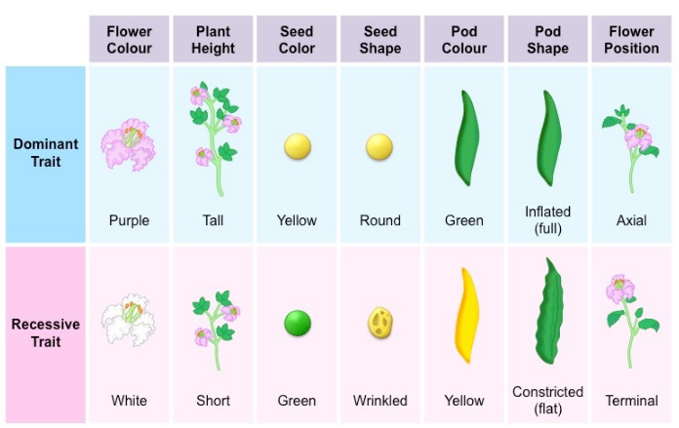

Slide 7
Segregation
Alleles separate during meiosis.
Each cell contains two alleles for each trait.
During meiosis, these alleles separate into haploid cells.
Notes:
Show two alleles separating.

