Slide 1
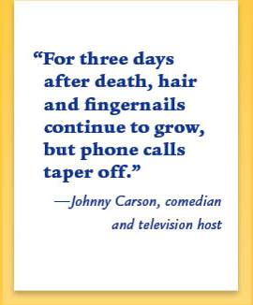
Hair
Hair
Anatomy and Use in Forensic Science

Slide 2
Objectives
You will understand that:
- Hair is class evidence.
- Hair can be used to back up circumstantial evidence.
- Hair absorbs and adsorbs substances both from within the body and from the external environment.
Notes:
Adsorbs: hold as a thin film on the outside surface

Slide 3
More Objectives:
You will be able to:
- Describe the structure of a hair.
- Explain the difference between human and animal hair.
- Explain which characteristics of hair are important for forensic analysis.
- Assess the probative value of hair samples.

Slide 4
Introduction
Human hair is one of the most frequently found pieces of evidence at the scene of a violent crime. It can provide a link between the criminal and the crime.
From hair, one can determine:
-If the source is human or animal
-Race (sometimes)
-Origin of the location on the source’s body
-Whether the hair was forcibly removed
-If the hair has been treated with chemicals
-If drugs have been ingested

Slide 5
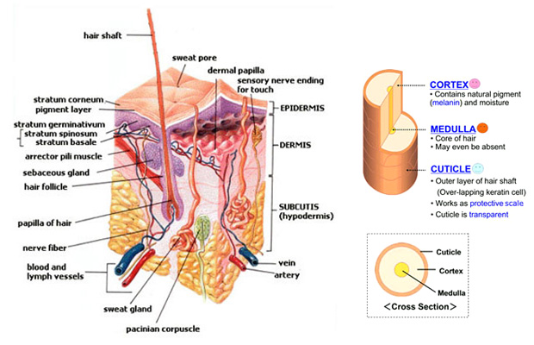
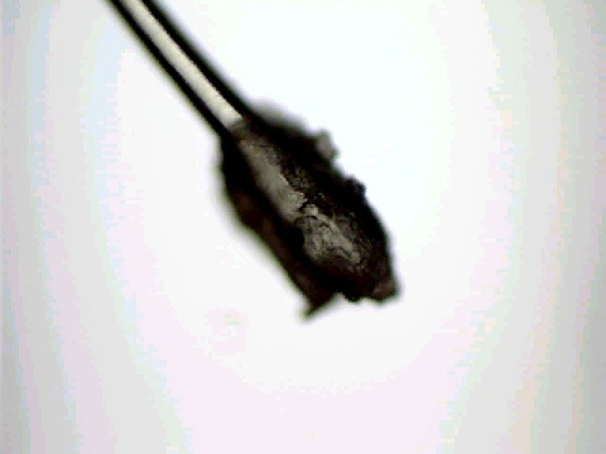
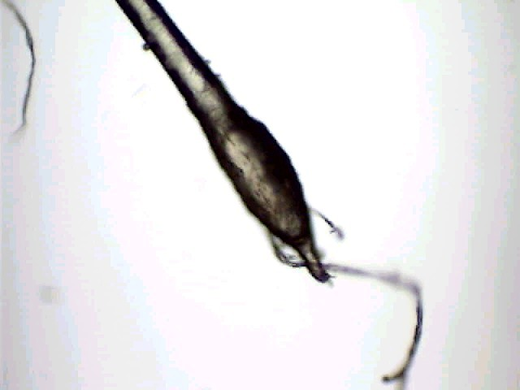
Skin Structure
Hair is composed of:
Hair Shaft
Follicle-hairs grows out of a follicle (has cells with DNA for analysis)
Root- hair extends from here (in the follicle) has cells with DNA

Slide 6
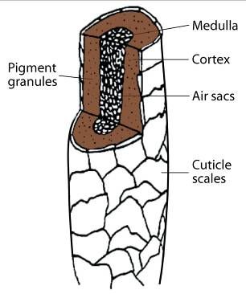
Hair Shaft
Composed of:
Cuticle—outside covering, made of overlapping scales that point to tip of hair. Scales are formed from cells that harden and flatten while progressing from the follicle
Cortex—inner layer made of keratin and embedded with pigment (give color to hair); also contains air sacs called cortical fusi
Medulla—inside layer running down the center of the cortex

Slide 7
The Cuticle
The cuticle is the outermost layer of hair which is covered with scales. The scales point toward the tip of the hair. Scales differ among species of animals and are named based on their appearance. The three basic patterns are:

Slide 8
Human Scales
In order to visualize the
scales:
1. Paint clear fingernail polish on a glass slide.
2. When the polish begins to dry, place a hair on the polish.
3. When it is almost dry, lift off the hair and observe the scale imprints.
What pattern is seen in this slide?
Imbricate

Slide 9
The Cortex
The cortex gives the hair its shape.
It has two major characteristics:
Melanin—pigment granules that give hair its color
Cortical fusi—air spaces, usually found near the root but may be found throughout the hair shaft

Slide 10
The Medulla
- The medulla is the hair core, that is not always visible.
- The medulla comes in different types and patterns.
Types:
Intermittent or interrupted
Fragmented
Continuous
Stacked
Absent—not present

Slide 11
Human Medulla
Human medulla may be continuous,
fragmented, or absent.
Notes:
What is this one???

Slide 12
Medullary Index
- Determined by measuring the diameter of the medulla and dividing it by the diameter of the hair.
Medullary index for human hair is generally less than 1/3.
For animal hair, it is usually greater than 1/2.
mouse

Slide 13
Hair Shape
Can be straight, curly, or kinky, depending on the cross-section, which may be round, oval, or crescent-shaped.
Round
(Straight)
Oval
(Curly)
Crescent moon
(Kinky)

Slide 14
Hair Growth
Terminology
Anagen—hair is actively growing; lasts up to 2-6 years (85% of head hairs).
Catagen—hair is not growing; a resting phase (2 weeks) blood supply is cut off.
Telogen—follicle is getting ready to push the hair out; lasts
1-4 months (10-15% of head hairs)
Grows about 0.4 mm per day, or 1 cm per month; approximately one-half inch per month

Slide 15
The Root
Human roots look different based on whether they have been forcibly removed or they are telogen hairs and have fallen out. Animal roots vary, but in general have a spear shape.
Fallen out
Forcibly removed

Slide 16
Hair Comparison
- Color
- Length
- Diameter
- Distribution, shape, and color intensity of pigment granules
Dyed hair has color in cuticle and cortex
Bleaching removes pigment and gives a yellow tint
- Scale types
- Presence or absence of medulla
- Medullary type
- Medullary pattern
- Medullary index

Slide 17
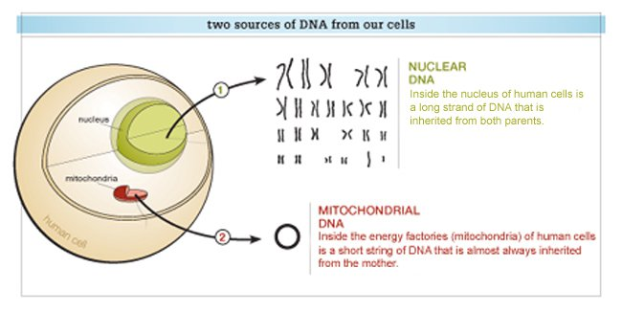
DNA from Hair
The root contains nuclear DNA. If the hair has been forcibly removed, some follicular tissue containing DNA may be attached.
The hair shaft contains abundant mitochondrial DNA, inherited only from the mother. It can be typed by comparing relatives if no DNA from the body is available. This process is more difficult and more costly than using nuclear DNA.

Slide 18
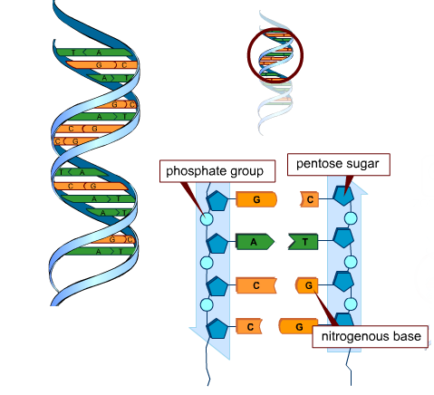
Structure of dna
- DNA is polymer (nucleic acids) composed of monomers called nucleotides.
- Nucleotides have 3 parts: phosphate group, 5-carbon sugar, and a nitrogenous base.
The nitrogenous base can be 1 of 4: Adenine, guanine, cytosine, or thymine.
Because only the bases can change, it is the order of bases that determines the genetic code.
- Individuals have unique sequences of bases in their DNA (except identical twins), and this information can be used to link questioned samples to known samples.

Slide 19
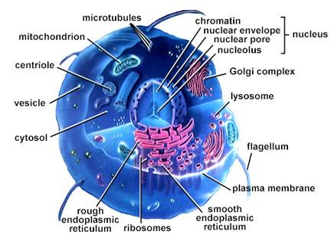
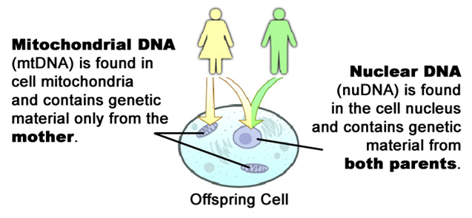
Mitochondrial Dna
Nuclear DNA makes exact copies of itself through mitosis, (cell division).
Mitochondrial DNA is DNA only found in the mitochondria. This DNA copies itself independently of nuclear DNA.
Mitochondria are inherited from the mother’s egg cell with little to no change in sequence from parent to offspring.
The high mutation rate allows for establishing relationships between people (more similar the mtDNA, more closely related)
Mitochondrial DNA was admitted into evidence for the first time ever in 1996 during State of Tennessee v. Paul Ware

Slide 20
Collection of Hair
Questioned hairs must be accompanied by an adequate number of control samples.
From victim
From possible suspects
From others who may have deposited hair at the scene
Control sample
50 full-length hairs from all areas of scalp
24 full-length pubic hairs

Slide 21
Hair Toxicology
Advantages:
Easy to collect and store
Is externally available
Can provide information on the individual’s history of drug use or evidence of poisoning
Collections must be taken from different locations on the body to get an accurate timeline.

Slide 22
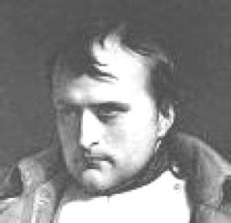
Hair Toxicology
Napoleon died in exile in 1821. -- By analyzing his hair, some investigators suggest he was poisoned by the deliberate administration of arsenic; others suggest that it was vapors from the dyes in the wallpaper that killed him.

