Slide 1
Homeostasis and Cells

Slide 2
Homeostasis
Cells are the basic unit of life.
Cells can be classified as an organism.
Just because an organism is only one cell, doesn’t mean it is “basic”
Cells must maintain a stable environment (homeostasis).

Slide 3
Multicellular Organisms and Homeostasis
How do the cells of multicellular organisms work together to maintain homeostasis?

Slide 4
Unlike most unicellular organisms, the cells of multicellular organisms do not live on their own.
They are interdependent; and must work together. (like a team)
Cells of multicellular organisms become specialized for particular tasks and communicate with one another to maintain homeostasis.

Slide 5
Cell Specialization
The cells of multicellular organisms are specialized, with different cell types playing different roles.
Some move to respond to the environment (RESPONSE)
No matter the role, each cell contributes to maintaining homeostasis.

Slide 6
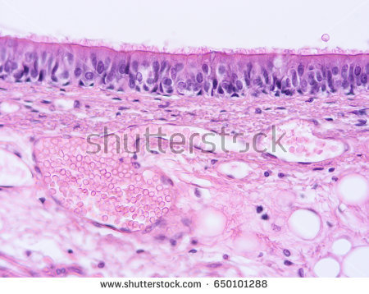
Specialized Animal Cells
The air we breath is full of particles of dust, smokes and bacteria.
Our trachea, “sweeps” what we breath out of our lungs.
These cells are filled with mitochondria.
What other specialized cell can you think of?

Slide 7
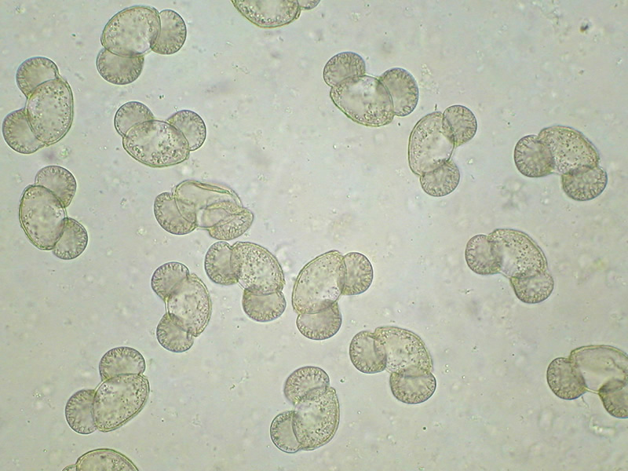
Specialized Plant Cells
How can a pine tree rooted in place produce offspring with a tree hundreds of meters away?
They release pollen grains.
Pollen grains are tiny and light, and have two tiny wings that allow them to float in the breeze.
Trees release millions of pollen grains in hopes of them landing on a seed cone to produce and offspring.

Slide 8
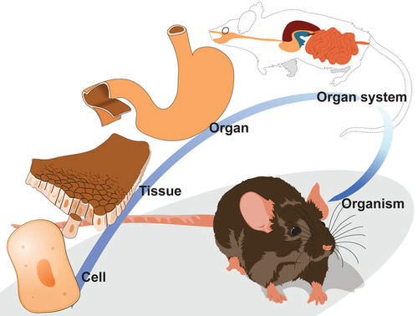
Levels of Organization
Tissue: a group of similar cells that perform a particular function.
Organ: Many groups of tissues working together.
Organ System: A group of organs that work together to perform a specific function.
Ex. Stomach, pancreas, and intestines work together as the digestive system.

Slide 9
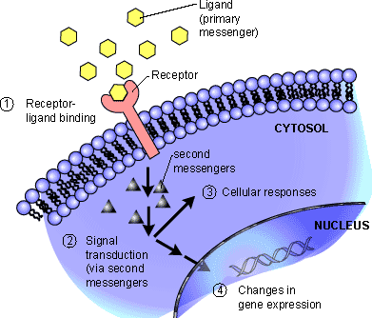
Cellular Communication
Cells in a large organism communicate by means of chemical signals that are passed from one cell to another.
These cellular signals can speed up or slow down the activities of the cells that receive them and can cause a cell to change what it is doing in a most dramatic way.
Certain cells can form connections, to hold them together.
To respond to one of these chemical signals, a cell must have a receptor to which the signaling molecule can bind.

