Slide 1
Bell Ringer 8/18
Explain what science means to you.
Needs to be 4-5 sentences

Slide 2
Unit 1: What is Science?
Chapter 1

Slide 3
Science….
Science is an organized way of gathering and analyzing evidence about the natural world.
1. Science deals with only the natural world.
2. Scientists collect and organize information in an orderly way, looking for patterns and connections among events.
3. Scientists propose explanations that are based on evidence, not belief.
4. Scientist then test those explanations with more evidence.

Slide 4
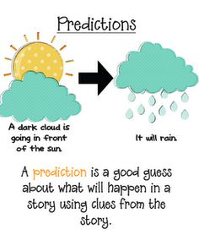
What are the goals?
To provide natural explanations for events in the natural world.
Science also aims to use those explanations to understand patterns in nature and to make useful predictions.

Slide 5
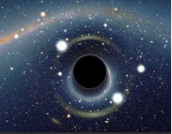
Do we know everything about everything?
Scientific knowledge helps us cure diseases, place satellites in orbit, and send instantaneous electronic communications (yes….that means your text messages).
Despite all we know, much of nature remains a mystery.
Science never stands still, almost every major scientific discovery raises more questions than it answers.
Science rarely “proves” anything, but aims to understand the natural world.

Slide 6
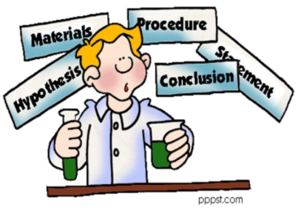
How do we study the world?

Slide 7
Scientific Method
1. Observing and Asking Questions
2. Inferring and Forming a hypothesis
3. Designing Controlled experiments
4. Control and Experimental Groups
5. Collecting and Analyzing Data
6. Drawing Conclusions

Slide 8
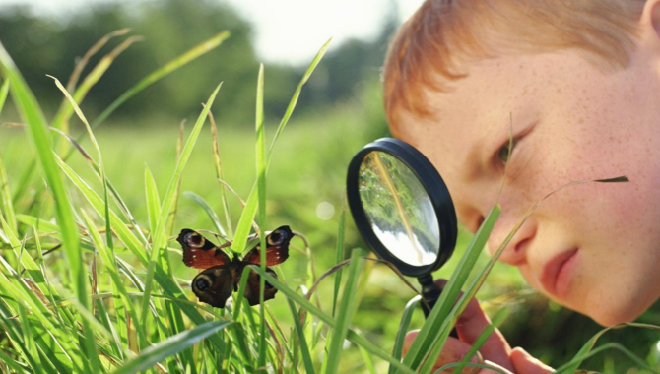
1. Observation
Observation is the act of noticing and describing events or processes in a careful and orderly way.
What do you notice about the two locations?

Slide 9
2. Inferring and Forming a hypothesis
An inference is a logical interpretation based on what scientists already know.
Inference, combined with a creative imagination, can lead to a hypothesis.
A hypothesis is a scientific explanation for a set of observations that can be tested in ways that support or reject it.
Notes:
Inference is based on what you have seen.
Hypothesis is what you think will happen when you test something.

Slide 10
3. Designing Controlled experiments
Testing a scientific hypothesis often involves designing an experiment that keeps track of various factors that can change, or variables.
When testing a hypothesis only one variable should be changed at a time.
Controlled experiment: an experiment where only one variable is changed.

Slide 11
Why do we need to control experiments?

Slide 12
If several variables are changed in the experiment, researchers can’t easily tell which variable is responsible for the results they observe.

Slide 13
Types of variables
Independent variable: the variable that is deliberately changed.
Dependent variable: the variable that is observed and that changes in response to the independent variable.
If I want to test the effects of herbicide on plant growth, what would be the
Independent variable?
Dependent variable?
Notes:
Independent: amount of herbicide
Dependent: growth
Qualitative: the plants turned yellow, wilted, etc
Quantitative: numerical value

Slide 14
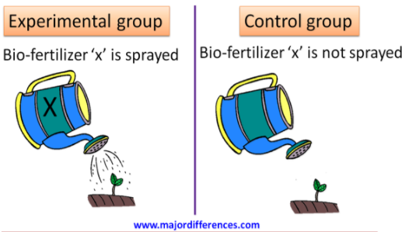
4. Control and Experimental Groups
Control group is exposed to the same conditions as the experimental group except for one independent variable.

Slide 15
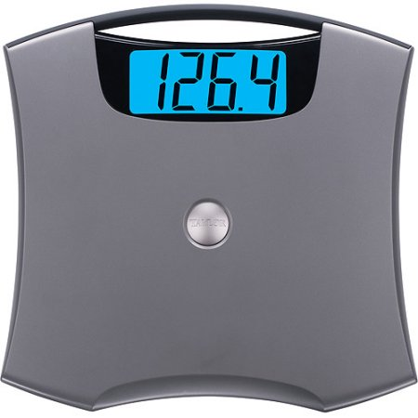
5. Collecting and Analyzing Data
Qualitative data: describes data that cannot be easily given a number.
It grew mold.
The leaves turned yellow.
The participant complained of pain.
Quantitative data: are numbers obtained by measuring/counting
The plant stem grew 5cm.
5 discs rose in the solution.

Slide 16
6. Drawing Conclusions
Scientists use experimental data as evidence to support, refute or revise the hypothesis being tested, and to draw a valid conclusion.
Hypothesis are not always fully supported.
Hypothesis may be reevaluated and revised; new predications are made, and new experiments are made.

Slide 17
Let’s test your knowledge.
What is the independent variable?
Color of light
What is the dependent variable?
Rate of plant growth
What group is the control?
1st group (white light)
What should be controlled?
Amount of water
Amount of nutrients
temperature

Slide 18
Hypothesis vs Law vs Theory
Hypothesis: testable explanation to a question
Law: Describes what nature does under certain conditions.
Theory: supported by large body of scientific evidence.

Slide 19
Lets test your knowledge…again.
With your shoulder partner complete the handout given.
You are only allowed to work/write on your side and must take turns between each one.

