Slide 1
Bell Ringer
On a clean sheet of paper, this will be turned in today.
What do you think is the:
Hardest part of biology
Easiest part of biology
What do you look forward to when coming to class
What do you not like about coming to class

Slide 2
Macromolecules

Slide 3
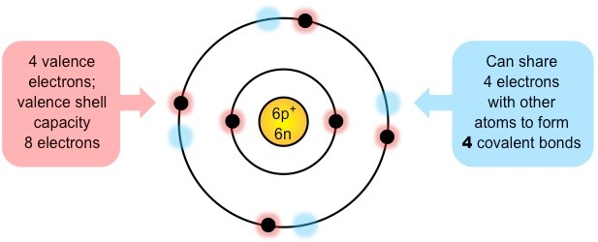
Organic Compounds
An organic compound is a compound that contains carbon and is found in living things.
Exceptions: Carbides, carbonates, carbon dioxide and cyanides.
Carbon
Forms the basis of organic life due to its ability to form large complex molecules via covalent bonding.
Can form up to four covalent bonds.
These properties allows carbon to form a wide variety of organic compounds that are chemically stable.
Notes:
Earth: Carbon based life

Slide 4
4 groups of organic compounds
Life is based on carbon compounds including carbohydrates, lipids, proteins and nucleic acids.
There are four principle groups of organic compounds that contribute to much of the structure and function of a cell.
1. Carbohydrates
Energy source
2. Lipids
Cell membranes
3. Proteins
Structural molecules
Cell signaling
4. Nucleic Acids
Genetic material

Slide 5
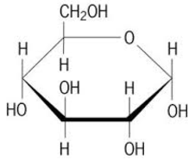
1. Carbohydrates
Monomer: Monosaccharides (single sugar)
Most monosaccharides form ring structures and can exist in different 3D configurations.
Disaccharide: two sugars
Polysaccharide: many sugars
Notes:
Ribose
Alpha and Beta glucoses

Slide 6
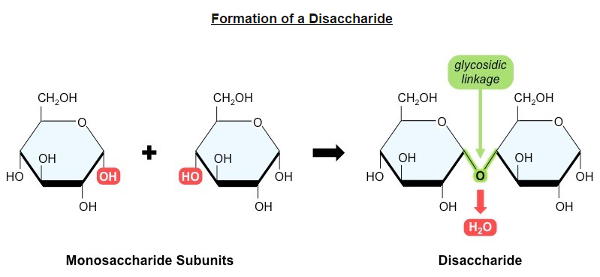
Monosaccharides
Monosaccharide monomers are linked together by condensation reactions to form disaccharides and polysaccharide polymers.

Slide 7
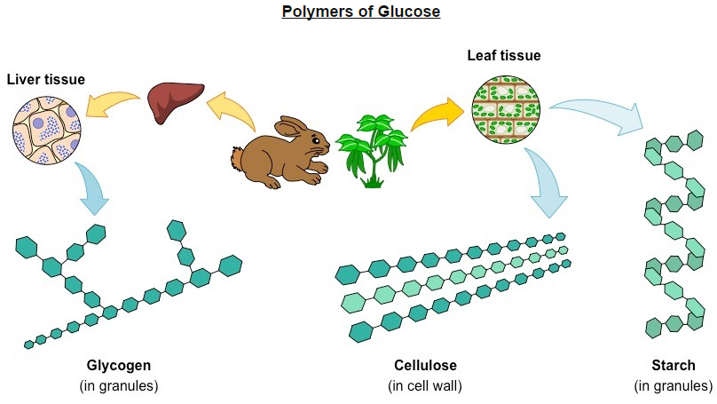

Slide 8
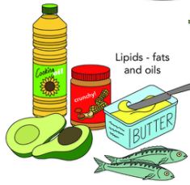
2. Lipids
Lipids are used to store energy.
Form biological membranes and protective coverings.
There are saturated and unsaturated lipids (fats).
S.2

Slide 9
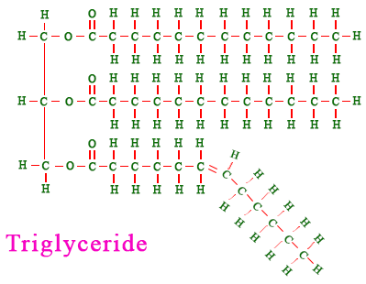
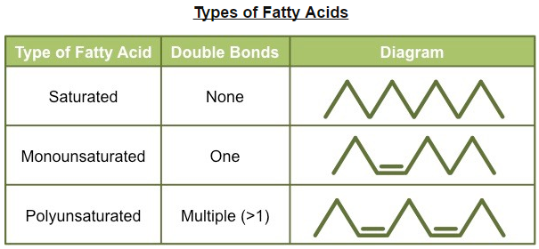

Slide 10
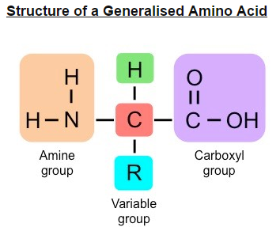
3. Proteins
Composed of monomers called amino acids, which join together to form polypeptide chains.
Each a.a. consists of a central carbon connected to an amine group (NH₂) and an opposing carboxyl group (COOH)
A variable group (‘R’ group) give different amino acids different properties (polar or non-polar)
S.2
Notes:
You need to be able to draw a general structure

Slide 11
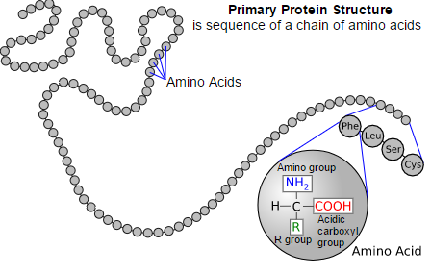
Primary Structure
The amino acid sequence determines the three-dimensional conformation of a protein.
Primary Structure: the order of amino acids, determines the way the chain will fold….(determined by the R-group)

Slide 12
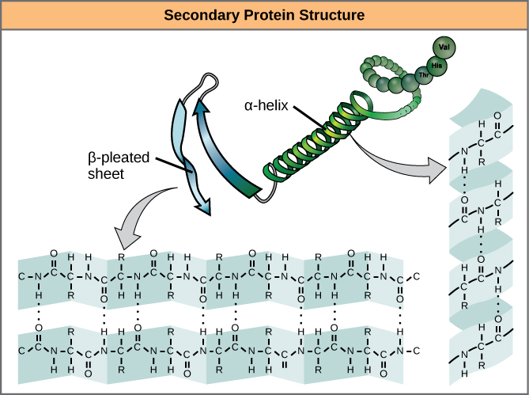
Secondary Structure
Amino acid sequences will commonly fold into two stable configurations, called the secondary structure.
Alpha helices – coil/spiral
Beta-pleated – directionally-oriented.
Both result from hydrogen bonding

Slide 13
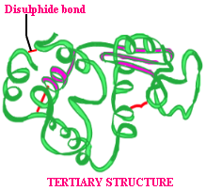
Tertiary Structure
The overall 3D configuration of the protein
Determined by the interaction between the variable side chains
These interactions may include hydrogen bonds, disulphide bridges, ionic interactions, polar associations, etc.

Slide 14
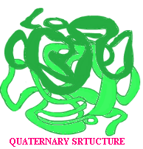
Quaternary Structure
Certain proteins possess a fourth level of structural organization.
Quaternary structures are found in proteins that consist of more than one polypeptide chain linked together.
Not all proteins will have a quaternary structure.

Slide 15
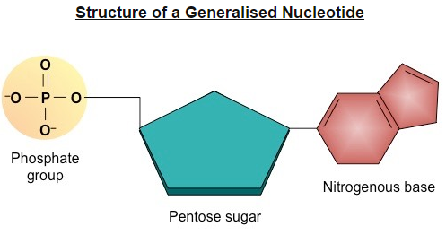
4. Nucleic Acids
Composed of monomers called nucleotides, which join together to form polynucleotide chains.
Each nucleotide consists of 3 compounds – a pentose sugar, a phosphate group and a nitrogenous base.
The type of sugar and composition of bases differs between DNA and RNA.
Nitrogenous base:
-Adenine
-Guanine
-Cytosine
-Thymine (DNA)
-Uracil (RNA)
Pentose Sugar: deoxyribose (DNA) or ribose (RNA)
Notes:
Looks similar to an a.a. don’t confuse them.

Slide 16
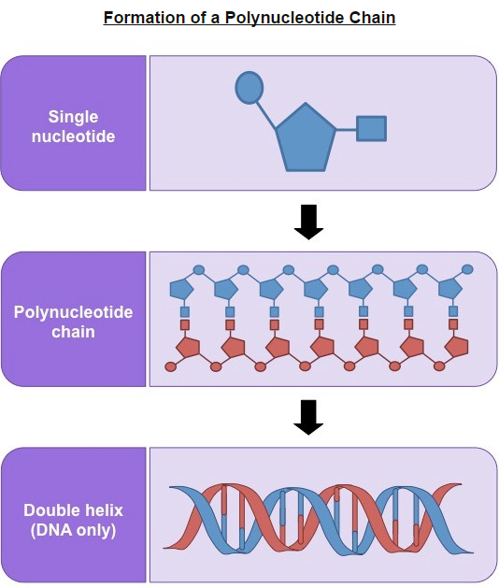

Slide 17
Think Time!!!
Summarize the four types of macromolecules:
Person 1-Proteins
Person 2-Nucleic Acids
Person 3-Carbohydrates
Person 4-Lipids

Slide 18
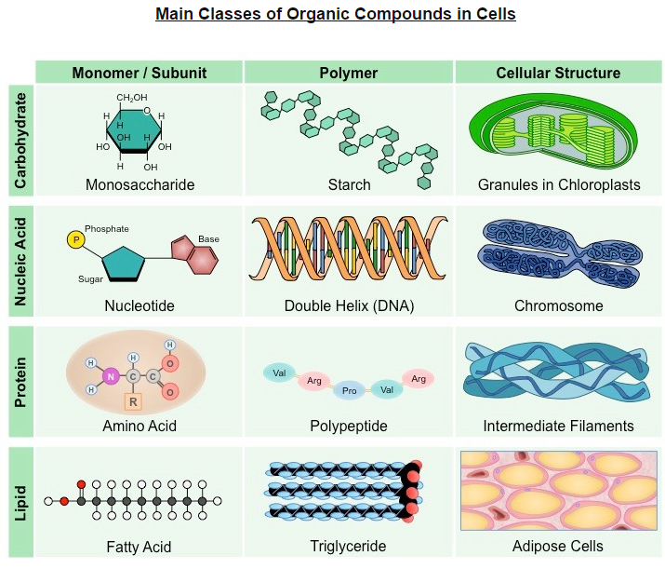

Slide 19
Forming macromolecules: Anabolic Reactions
Anabolism is the synthesis of complex molecules from simpler molecules including the formation of macromolecules by condensation reaction.
Condensation reactions occur when monomers are covalently joined and water is produced as a by-product.
Notes:
Anna the builder

Slide 20
Catabolism-breaking down
Catabolism is the breakdown of complex molecules into simpler molecules including the hydrolysis of macromolecules into monomers.
Notes:
Break-dancing cat

