Slide 1
Intro…
In order for organisms to carry out sexual reproduction, their gametes must contain half the number of chromosomes found in somatic (body cells).
When the gametes undergo fertilization, the full chromosome number will be restored.
If the chromosomes were not reduced in the gametes, the number of chromosomes resulting from sexual reproduction would be twice that of the parent.

Slide 2
Ploidy
Ploidy refers to the number of chromosomal sets in the nucleus of a cell.
Haploid: one set of chromosomes
Diploid: Two sets of chromosomes
Polyploid: More than two sets of chromosomes

Slide 3
Meiosis
Meiosis occurs only in reproductive cells during the formation of gametes (sex cells).
One diploid nucleus divides by meiosis to produce four haploid nuclei.
Just like in mitosis, the chromosomes must go through the S-phase of the cell cycle in order to copy their genetic material. (Must go through interphase).
DNA is replicated before meiosis so that all chromosomes consist of two sister chromatids.
Meiosis involves two divisions of the nucleus.
The first division, Meiosis I, separates homologous chromosomes.
The second divisions, Meiosis II, separates the connected chromatids.
The end products of meiosis are sperm and eggs – the reproductive gametes.

Slide 4
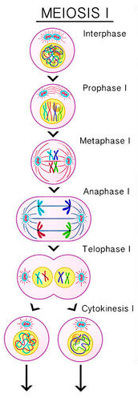
Meiosis I: Separation of homologous chromosomes
Prophase I:
Homologous chromosomes pair up
Crossing over is possible
The nuclear membrane breaks down.
Metaphase I:
Homologous chromosomes line up as pairs at the metaphase plate
Orientation of pairs of homologous chromosomes prior to separation is random.
Anaphase I:
Homologous chromosomes are pulled apart and move to opposite poles of the cell.
Telophase I:
Individual replicated chromosomes are located at the opposite poles of the cell as haploid sets.
Key Events:
Nuclei are reduced from diploid (2n) to haploid (n)
Crossing over occurs during prophase I.
2 new genetically different haploid cells are produced by cytokinesis.
Independent assortment of genes is due to the random orientation of pairs of homologous chromosomes in meiosis I

Slide 5
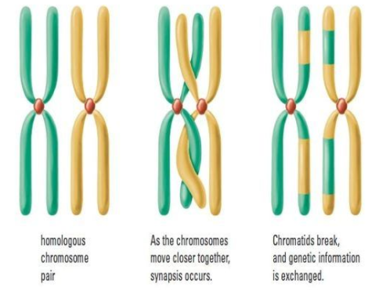
Crossing Over
Crossing over and random orientation promotes genetic variation.
Crossing over is the exchange of DNA material between non-sister homologous chromosomes.
Crossing over produces new combinations of alleles on the chromosomes of the haploid cells.
Chiasmata formation between non-sister chromatids can result in an exchange of alleles.

Slide 6
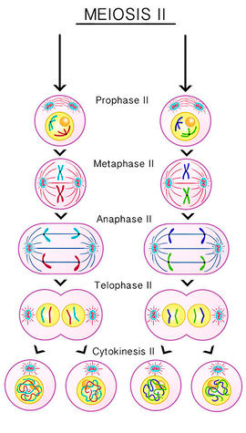
Meiosis II: Separation of Sister Chromatids
Prophase II:
Each haploid set of chromosomes is visible in the two cells.
Metaphase II:
Individual chromosomes line up at the metaphase plate.
Anaphase II:
Replicated chromosomes (chromatids) separate into individual chromosomes.
Telophase II:
Nonreplicated chromosomes are located at the poles of the cell.
Key Events:
Replicated chromosomes are separated into nonreplicated chromosomes by the separation of sister chromatids into individual chromosomes.
Four new, genetically different haploid cells are produced by cytokinesis.

Slide 7
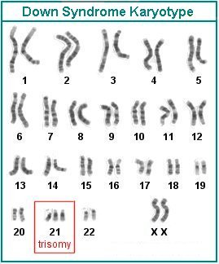
Non-Disjunction
Non-disjunction can cause Down syndrome and other chromosome abnormalities.
Meiosis is sometimes subject to errors.
One example of this is when homologous chromosomes fail to separate at anaphase.
This can happen with any of the pairs of homologous chromosomes, both chromosomes move to one pole and neither to the other.
This results in the gamete having either an extra chromosome or deficient in a chromosome.
Studies have shown that age of parents influences changes of non-disjunction.

Slide 8
