Slide 1
Photosynthesis

Slide 2
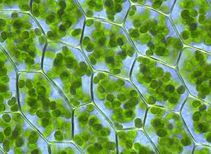
Chlorophyll
Plant’s gather the sun’s energy with light-absorbing molecules called pigments.
Photosynthetic organisms capture energy from sunlight with pigments.
The plants’ principal pigment is chlorophyll.

Slide 3
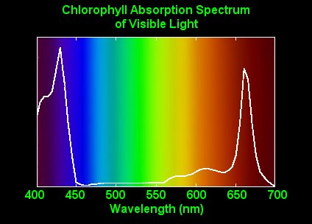
Light Spectrum

Slide 4
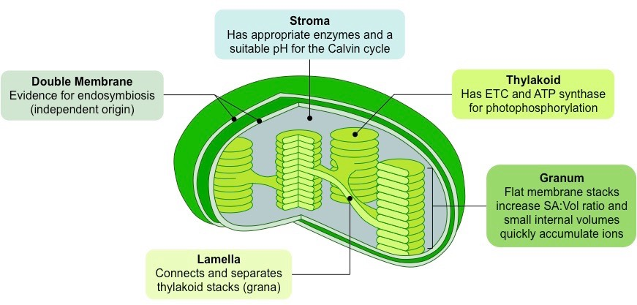
Chloroplasts
Photosynthesis takes place inside organelles called chloroplasts.
Chloroplasts contain an abundance of saclike photosynthetic membranes called thylakoids.
Thylakoids are interconnected and arranged in stacks as grana.
The fluid portion of the chloroplast, outside of the thylakoid, is known as the stroma.

Slide 5
Energy Collection
Light is a form of energy.
Chlorophyll absorbs visible light, which is energy.
When light is absorbed, a large fraction of that light energy is transferred directly to electrons in the chlorophyll molecule itself.
By raising the energy levels of these electrons, light energy can produce a steady supply of high-energy electrons, which is what makes photosynthesis work.

Slide 6
High Energy Electrons
In a chemical sense, the high-energy electrons produced by chlorophyll are highly reactive and require a special “carrier”.
Like using a mitt to carry a hot potato.
An electron carrier is a compound that can accept a pair of high-energy electrons and transfer them, along with most of their energy, to another molecule.
One of these carriers molecules is a compound known as NADP⁺.
NADP⁺ accepts and holds 2 high-energy electrons, along with a hydrogen ion (H⁺)
By adding a H⁺, energy is “trapped” in chemical form.
The NADPH can then carry the high-energy electrons that were produced by light absorption in chlorophyll to chemical reactions elsewhere in the cell.
Notes:
Nicotinamide adenine dinucleotide phosphate

Slide 7
Overview of Photosynthesis
Many steps are involved in the process of photosynthesis.
Photosynthesis uses the energy of sunlight to convert water and carbon dioxide into high-energy sugars and oxygen.
Plants then use the sugars to produce complex carbohydrates such as starches, and to provide energy for the synthesis of other compounds, including proteins and lipids.
6CO₂ + 6H₂0 → C₆H₁₂0₆ + 6O₂
Carbon dioxide + water → Sugars + Oxygen

Slide 8
Light Dependent Reaction
The first reaction of photosynthesis.
It requires the direct involvement of light and light-absorbing pigments.
The light-dependent reaction use energy from sunlight to produce energy-rich compounds such as ATP.
These reactions take place within the thylakoids.
Water is required in these reactions as a source of electrons and hydrogen ions.
Oxygen is released as a byproduct.

Slide 10
Light Independent Reaction
Plants absorb carbon dioxide from the atmosphere and complete the process of photosynthesis by producing carbon-containing sugars and other carbohydrates.
During this stage, ATP and NADPH molecules produced in the light-dependent reactions are used to produce high-energy sugars from carbon dioxide.
The light-independent reactions take place outside the thylakoids, in the stroma.

