Slide 1
Photosynthesis

Slide 2
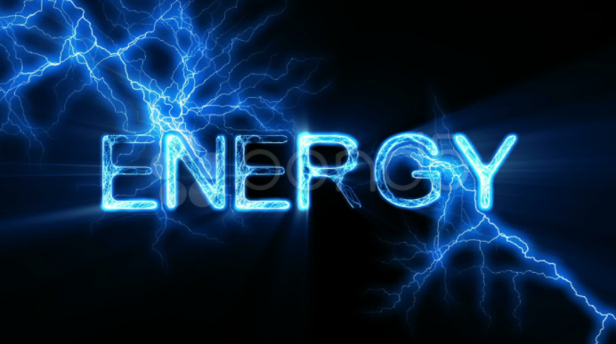
Where do we get energy from?

Slide 3
Energy
Energy is needed to do work.
Even when you are sleeping your cells are still busy at work.
Energy comes in many forms.
Light, heat and electric

Slide 4
Energy can be stored as chemical compounds.
When you light a candle, the wax melts, soaks into the wick, and is burned.
As the wax is broken down, chemical bonds are broken.
CO2 and water are produced as the bonds are broken and new ones are formed.
These bonds are a lower energy state and energy in the form of heat and light are released”.

Slide 5
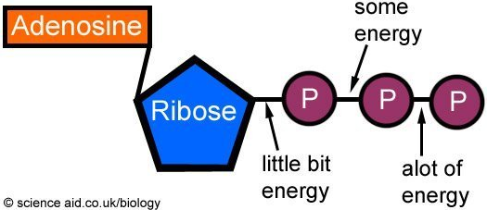
Adenosine triphosphate (ATP)
Living things use chemical fuel as energy. .
Adenosine triphosphate is a compound that can store and release energy.

Slide 6
Storing Energy
Adenosine diphosphate (ADP) is a compound that looks almost like ATP, except it has two phosphates.
By adding another phosphate group to the ADP molecule, producing ATP it stores energy.

Slide 7
Releasing Energy
Cells can release the energy that was stored by breaking the bonds between the second and third phosphate groups.
*ATP can easily release and store energy by breaking and re-forming the bonds between its phosphate groups.
This characteristic of ATP makes it exceptionally useful as a basic energy source for all cells.

Slide 8
Using Biochemical Energy
One way our cells use energy from ATP is to carry out active transport.
Many cell membranes contain sodium-potassium pumps.
Membrane proteins that pump sodium ions (Na+) out of the cell and potassium ions (K+) into the cell.
ATP provides the energy that keeps this pump working, maintaining a regulated balance.
ATP powers movement, including muscle contraction and the wavelike motion of the cilia and flagella.

Slide 9
Long Term Energy
ATP is a useful source of energy, but it does not store well.
ATP is perfect for short term energy, but not long term.
A single molecule of glucose, stores more than 90 times the energy required to add a phosphate group to ADP to make ATP.
Therefore, it is more efficient for cells to keep only a small amount of ATP on hand.
The cells will use the energy stored from glucose to regenerate ATP when needed.

Slide 10
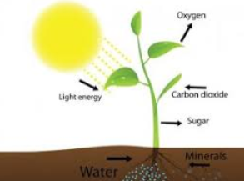
How do we get Energy?
Cells are not born with ATP – they must produce it or consume it from organisms that can produce their own food.

Slide 11
Autotrophs
Organisms that make their own food are called autotrophs.
All life is dependent on organisms that can make their own food.
Autotrophs make their food using the sun (light energy) to make sugars (chemical energy), or carbohydrates.
This process is called photosynthesis.

Slide 12
Heterotrophs
Organisms that obtain their food by consuming other living things are known as heterotrophs.
Some heterotrophs get their food by eating plants, such as grass.
Others, get theirs food from consuming plant-eating animals.

Slide 13
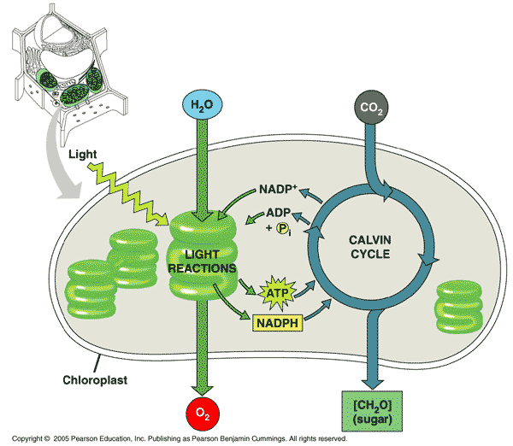
Photosynthesis
In the process of photosynthesis, plants convert the energy of sunlight into chemical energy stored in the bonds of carbohydrates.

Slide 14
Give me an example of an autotroph?

Slide 15
What is the principal chemical compound that living things use to store energy is?

Slide 16
Compare/Contrast heterotrophs and autotrophs.

