Slide 1
Spring 2017 Final Review
Cells N’ Things | Physiology | Draw N’ Things | Reproduction | Grab Bag
100 | 100 | 100 | 100 | 100
200 | 200 | 200 | 200 | 200
300 | 300 | 300 | 300 | 300
400 | 400 | 400 | 400 | 400
500 | 500 | 500 | 500 | 500

Slide 2
Cells N’ Things for 100
List the key statements of the cell theory.

Slide 3
Cells N’ Things for 200
State and define the seven functions of life displayed by all living organisms.
Notes:
Applied

Slide 4
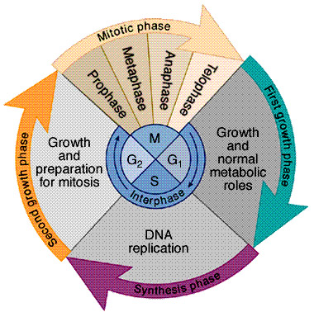
Cells N’ Things for 300
Identify what the image below relates to:
Notes:
Normal, Gravity

Slide 5
Cells N Things for 400
Outline the process of meiosis.

Slide 6
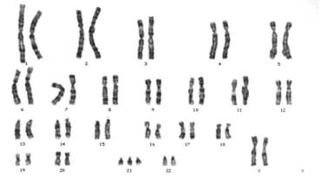
Cells N Things for 500
Describe the individual below:

Slide 7
Physiology for 100
True or False: Urine is filtered from the capillaries into the glomerulus and the bowman’s capsule.

Slide 8
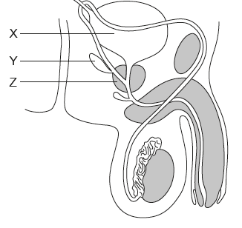
Physiology for 200
What is the role of the structure circled below?
Notes:
Tendency for objects to stay as they are.

Slide 9
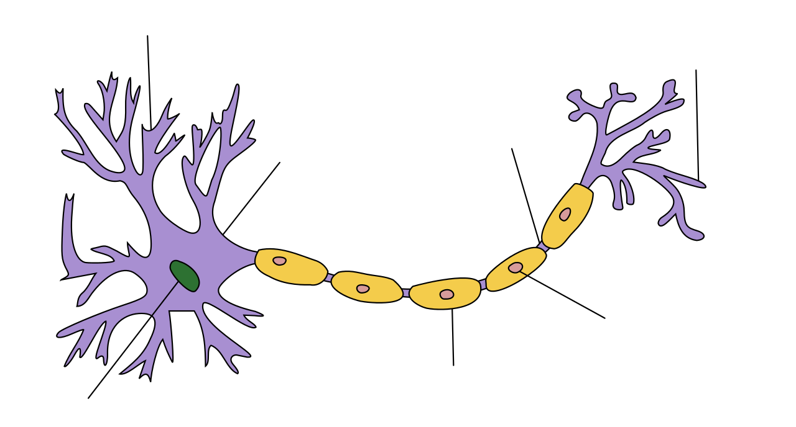
Physiology for 300
Label the diagram below:
Notes:
Behind you. inertia

Slide 10
Physiology for 400
How are cuts in the skin sealed by blood clots?

Slide 11
Physiology for 500
Explain the process of muscle contraction.

Slide 12
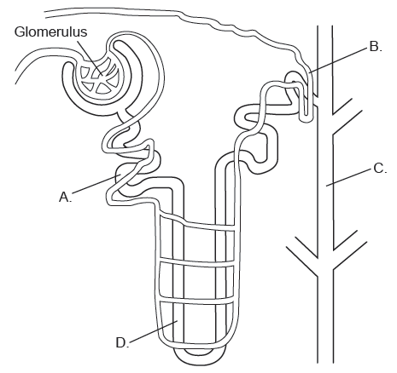
Draw N Things for 100
Describe the process that occurs at the glomerulus.
Notes:
F = M x A

Slide 13
Draw N Things for 200
Draw and annotate a picture of a prokaryotic cell.

Slide 14
Draw N Things for 300
Outline blood flow in the human body.
Notes:
0.5 m/s2

Slide 15
Draw N Things for 400
Draw and label a sarcomere.

Slide 16
Draw N Things for 500
Draw, label, and annotate the digestive system.

Slide 17
Reproduction for 100
Identify the process in which mature sperm are produced.
Notes:
For every action there is an equal or opposite reaction

Slide 18
Reproduction for 200
Identify the hormones needed to promote the thickening of the endometrial layer.

Slide 19
Reproduction for 300
Draw a and annotate a picture of a mature sperm cell.

Slide 20
Reproduction for 400
Describe the roles of progesterone and estrogen during pregnancy.

Slide 21
Reproduction for 500
Compare and contrast spermatogenesis and oogenesis.

Slide 22
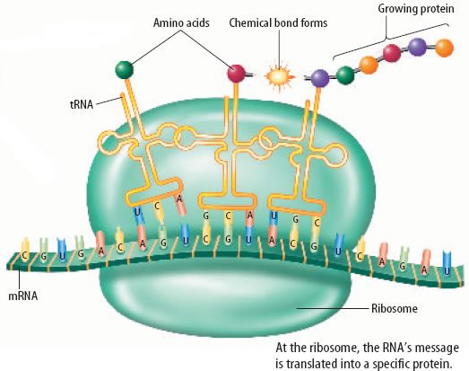
Grab Bag for 100
Identify the process in the picture below:
Notes:
A force created by the attraction of two masses

Slide 23
Grab Bag for 200
Compare plant and animal cells.
Notes:
W = Mass x Acceleration (due to gravity)

Slide 24
Grab Bag for 300
True or False:
It was once believed that non-living things could produce life.
New cells can appear by spontaneous generation.
Notes:
Gravity goes down as distance increases

Slide 25
Grab Bag for 400
Fill in the blanks:
____ include organisms in the kingdoms protoctists, fungi, plants, and animals.
Electron micrographs have revealed eukaryotic cells have cells with a more _____ structure. They have compartments surrounded by ___. These compartments are termed _____.
Notes:
As mass increases gravity increases

Slide 26
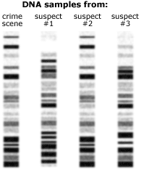
Grab Bag for 500
Which suspect was at the crime? Explain how you know.

Slide 27
Living organisms are made up of one or more cells.
There is no smaller unit of life than cells.
Every new cell must come from pre- existing cells.

Slide 28
Metabolism
Reproduction
Growth
Homeostasis
Response
Excretion
Nutrition

Slide 29
The Cell Cycle

Slide 30
Prophase I
Homologous chromosomes form tetrads in which two non-sister chromatids exchange genetic information. This is known as crossing over.
Metaphase I
Spindle fibers arrange homologous chromosomes along the equator of the cell.
Anaphase I
Pairs of homologous chromosomes are separated and pulled to opposite ends of the cell.
Telophase I
Prophase II
Metaphase II
Spindle fibers arrange chromosomes along the equator of the cell.
Anaphase II
Sister chromatids are pulled to opposite poles of the cell.
Telophase II
A new nuclear membrane can form around each of the four new cells.
Each cell has a different combination of half the genetic material of the original parent cell.

Slide 31
This individual is a female with down-syndrome.

Slide 32
FALSE!
IT’S NOT URINE! ITS FILTRATE!

Slide 33
Epididymis
Helps support maturation of sperm
Area where sperm are received, become mature, and are capable of swimming motion via flagella.

Slide 35
Skin is cut and blood vessels are damaged.
Clotting factors are released.
Platelets stick to the damaged area and release clotting factors.
Clotting factors convert prothrombin into thrombin.
Thrombin is an enzyme that converts the soluble plasma protein fibrinogen into insoluble fibrin.
Fibrin forms a network of long fibers across the damaged area.
Red blood cells are trapped in the fibrin network to form a blood clot.

Slide 36
A motor neuron carries an action potential until it reaches the final synapse.
Acetylcholine is released into synapse between the neuron and the sarcolemma.
ACH binds to receptors on sarcolemma.
Sarcolemma ion channels open and sodium ions move through the membrane.
Action potential moves through T tubules, causing release of Calcium ions from the sarcoplasmic reticulum.
Calcium ions rush into the sarcoplasm.
Calcium binds to troponin and exposes binding sites on actin.
Myosin heads attach to binding sites on actin.
Myosin heads flex toward center of sarcoplasm.
ATP binds to myosin head, resulting in detachment of myosin from the actin and await another action potential from motor neuron.

Slide 37
Notes:
Describe the process of ultrafiltration.
Caused by high blood pressure from size differences of the afferent and efferent arteriole.

Slide 42
Spermatogenesis

Slide 43
Progesterone and Estrogen

Slide 45
Progesterone:
Helps maintain highly vascular tissue of the uterus/placenta.
Suppresses contractions of smooth muscle of the uterus.
Estrogen:
Encourages muscle growth of uterus.
“antagonizes” the action of progesterone to suppress uterine contractions.
Stimulate mammary gland development late in pregnancy in preparation for milk production.
Induces production of oxytocin receptors in uterine muscles late in pregnancy.
Notes:
Oxytocin will stimulate contractions for birth.

Slide 46
Spermatogenesis | Oogenesis
Mitosis replaces germinal cells daily Some cell growth occurs before meiosis I begins. Two divisions of meiosis result in four haploid spermatozoa Spermatids must remain in seminiferous tubules until differentiation into spermatozoon occurs. Gamete is very small with little cytoplasm and limited organelles. Millions of spermatozoa produced every day throughout life (starts at puberty) | Mitosis replaces germinal cells only early in a female’s development. Great deal of growth occurs before meiosis I begins. Two cell divisions of meiosis results in one ovum and three possible polar bodies. Differentiation of the oocyte into an ovum occurs partly in the ovary and continues after ovulation. Gamete is extremely large with great deal of cytoplasm, nutrients, and organelles. Ovulation of one of a total of thousands of oocytes occurs with each menstrual cycle and stops at menopause.

Slide 47
TRANSLATION!

Slide 49
1. True
2. False

Slide 50
Fill in the blanks:
Eukaryotes include organisms in the kingdoms protoctists, fungi, plants, and animals.
Electron micrographs have revealed eukaryotic cells have cells with a more complex structure. They have compartments surrounded by membranes. These compartments are termed organelles.

Slide 51
Suspect 2:
Gel electrophoresis separates DNA molecules based on density.
Banding patterns match the DNA sample from the crime scene.

