Slide 1
Final Review
Question and Answer
Samples and Techniques

Slide 2
In the production of monoclonal antibodies, B-cells are fused to make hybridoma cells. What can hybridoma cells do?
Divide endlessly
Ingest antigens
Become memory cells
Bind to antibodies
Notes:
A

Slide 3
A skeletal muscle contains bundles of elongated muscle fiber cells. What is the longest structure within each fiber?
A myosin filament
The sarcomere
A myofibril
The Z line
Notes:
C

Slide 4
What is a function of synovial fluid in the elbow joint?
Joins the humerus to the radius and ulna
Grows red blood cells
Protects the biceps
Allows easy movement
Notes:
D

Slide 5
Where are microvilli located in the nephron?
Glomerulus
Proximal convoluted tubule
Loop of Henle
Collecting duct
Notes:
B

Slide 6
Through what process does a spermatid become a functioning spermatozoan?
Mitosis
Differentiation
Fertilization
Meiosis
Notes:
B

Slide 7
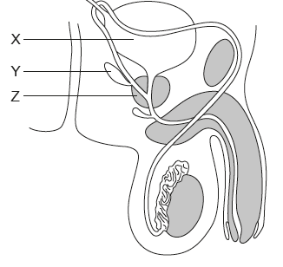
Where is prostate cancer likely to start developing?
In Y and Z only
In X only
In Z only
In X, Y, and Z
Notes:
C

Slide 8
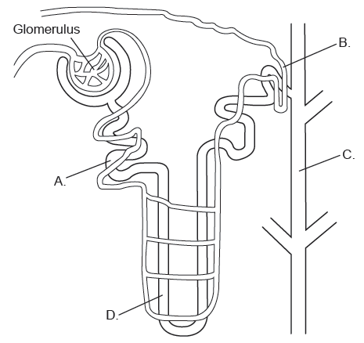
In what part of the nephron would most glucose be reabsorbed?
Notes:
A

Slide 9
In what region of the kidney is the glomerulus found?
Cortex only
Medulla only
Cortex and medulla
Pelvis
Notes:
A

Slide 10
What is the function of the epididymis in the male reproductive system?
To stimulate sperm by secreting testosterone
To store sperm in the final stages of maturation
To provide fluid to nourish the sperm
To transport the sperm for the testes to the urethra
Notes:
B

Slide 11
From where is human chorionic gonadotropin (HCG) secreted in early pregnancy?
Embryo
Corpus luteum
ovary
Pituitary gland
Notes:
A

Slide 12
What results from the fusion of tumor cells with B-cells?
The inability of B-cells to divide
The production of monoclonal antibodies
The production of antigens
The activation of helper T-cells
Notes:
B

Slide 13
What is the main role of nerves in human movement?
To move joints
To causes muscles to stretch
To transport pain signals that indicate muscle injuries
To stimulate muscle contraction
Notes:
D

Slide 14
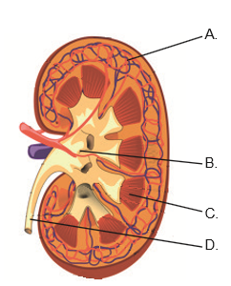
What letter correctly identifies the medulla?
Notes:
C

Slide 15
What event takes place during normal fertilization?
The egg divides to form a blastocyst
The acrosome fuses with the egg membrane
The entire sperm cell enters the egg cytoplasm
The cortical granules fuse with the egg membrane
Notes:
D

Slide 16
What is secreted after implantation of the blastocyst in the uterine wall?
Estrogen which stimulates the degeneration of the corpus luteum
HCG which prevents the degeneration of the corpus luteum
Estrogen which prevents the degeneration of the corpus luteum
HCG which stimulates the degeneration of the corpus luteum
Notes:
B

Slide 17
Which ions are released from the sarcoplasmic reticulum when a skeletal muscle fiber contract?
Potassium
Sodium
Calcium
Chloride
Notes:
C

Slide 18
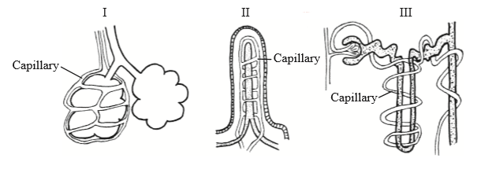
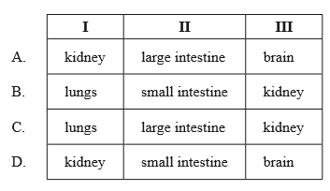
Where are structures I, II and III found in the human body?
Notes:
B

Slide 19
What is a blastocyst?
An unfertilized egg surrounded by follicle cells
An unfertilized egg cell expelled by menstruation
The follicle when it has swelled up with fluid
The embryo when it has become a hollow ball of cells
Notes:
D

Slide 20
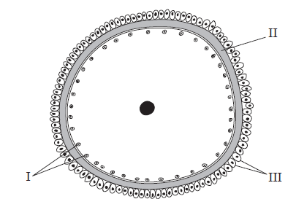
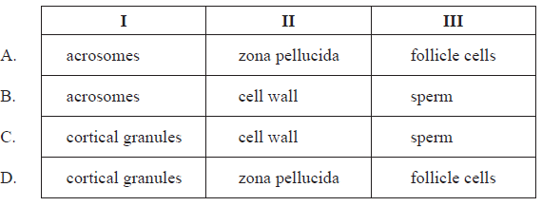
What are the structures labelled I, II and III?

Slide 21
What is the role of testosterone in spermatogenesis?
It stimulates interstitial cells
It stimulates Sertoli cells
It inhibits the germinal epithelium
It inhibits the prostate gland
Notes:
B

