Slide 1
Structure of DNA

Slide 2
Nucleic Acids
DNA and RNA are polymers of nucleotides.
Nucleotides are composed of three parts:
Phosphate group
5-carbon monosaccharide (sugar)
Nitrogenous base
Notes:
Draw a nucleotide

Slide 3
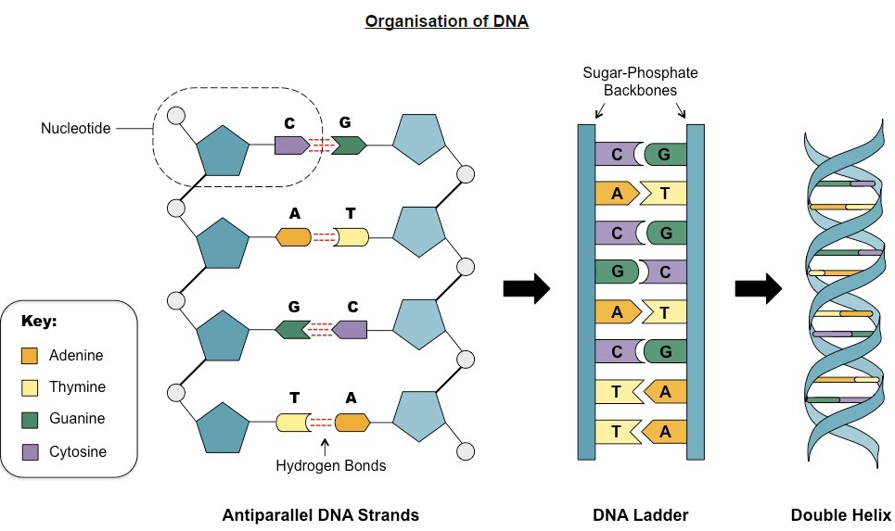
Covalent bond
Notes:
Chargaffs Rule: Equal A-T; C-G

Slide 4
Watson and Crick
1953 correctly proposed the structural organization of the DNA molecule.
Using trial and error they built several models.
First was triple helix
Bases on outside, sugar and phosphate on the inside.
Nitrogenous bases were not initially configured correctly and did not demonstrate complementarity.

Slide 5
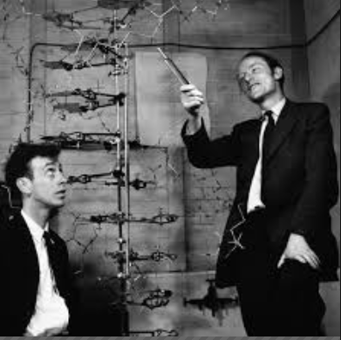

Slide 6
Rosalind Franklin and Maurice Wilkins
Used a method of X-ray diffraction to investigate the structure of DNA.
DNA was purified and then fibers were stretched in a thin glass tube
The DNA was targeted by a X-ray beam, which was diffracted when it contacted an atom.
The scattering pattern of the X-ray was recorded on a film and used to elucidate details of molecular structures.

Slide 7
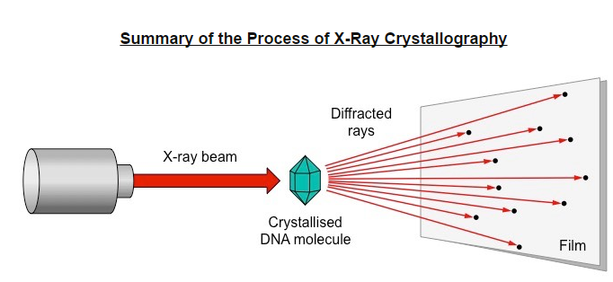

Slide 8
From scattering pattern produced by a DNA molecule, certain inferences could be made about its structure
Composition: DNA is double stranded
Orientation: Nitrogenous bases are closely packed together on the inside and phosphates form an outer backbone.
Shape: The DNA molecule twists at regular intervals to form a helix.

Slide 9
