Slide 1
Transcription & Gene Expression
Topic 2.6 & 7.2

Slide 2
Understandings:
Transcription is the synthesis of mRNA copied from the DNA base sequences by RNA polymerase.
Gene expression is regulated by proteins that bind to specific base sequences in DNA.
The environment of a cell and of an organism has an impact on gene expression.
Nucleosomes help to regulate transcription in eukaryotes.
Transcription occurs in a 5’ to 3’ direction.
Eukaryotic cells modify mRNA after transcription.
Splicing of mRNA increases the number of different proteins an organism can produce.
Application & Skills:
The promoter as an example of non-coding DNA with a function.
Analysis of changes in DNA methylation patterns.

Slide 3
Getting together!!!
DNA is in the nucleus.
Ribosome is in the cytoplasm.
We need them together to make proteins.
How do we get them together?
RNA!!!!

Slide 4
Central Dogma
First proposed – Crick (1956)
DNA → RNA → Protein
Notes:
First arrow: Transcription
Second arrow: Translation

Slide 5
Transcription: DNA → RNA
In replication, DNA helicase is used to unzip DNA.
In transcription, RNA polymerase is used to separate the two DNA strands.
RNA polymerase will join with the region called the “promoter” region.

Slide 6
Promoter: (non-coding sequence) responsible for the initiation of transcription.
Coding Sequence: Region of DNA that is transcribed by RNA polymerase
Terminator: RNA polymerase will continue to transcribe until it reaches this point.

Slide 7
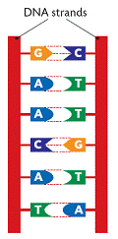
Which strand do we copy??
They are complementary, meaning not exactly the same.
Codons: three nucleotides; codes for proteins or start and stop regions.
So, complementary will code for different proteins.

Slide 8
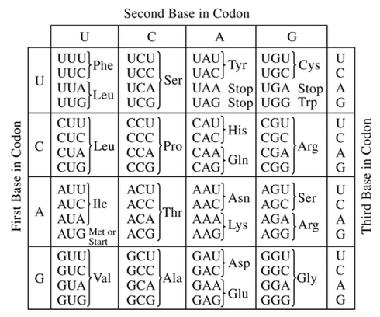
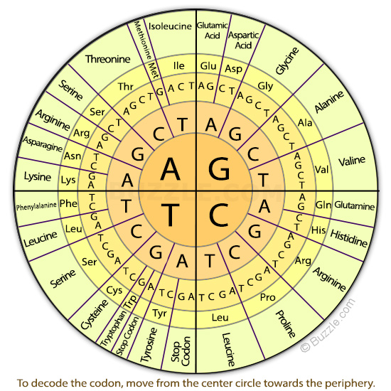

Slide 9
Antisense vs Sense
Each strand is complementary to the other, so there is a difference in the code of the strands.
Codon → amino acids → proteins
Antisense strand (template strand) is the strand that is transcribed into RNA.
Complementary to the RNA sequence
Sense strand (coding strand) is the strand that is not transcribed into RNA.
Notes:
The complementary strand to antisense will be the same as the sense strand.

Slide 10
Notes:
RNA polymerase is what “unzips” the genes, not helicase
TATA box

Slide 11
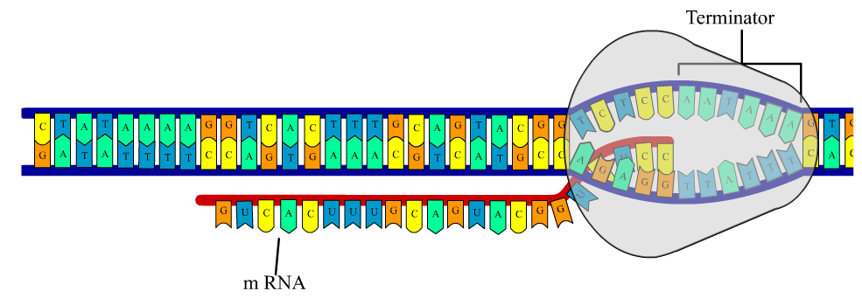

Slide 12
Notes:
Nucleoside triphosphates pair to complementary base pair, the releasing of phosphates provides energy. This release of energy causes polymerization (binding a.a. tgether) of mRNA.
This process is referred to as elongation.

Slide 13
Overview of Transcription
The process of transcription can be divided into three main steps: initiation, elongation and termination.
In initiation, RNA polymerase binds to the promoter and causes the unwinding and separation of DNA strands.
Elongation occurs as the RNA polymerase moves along the coding sequence, synthesis RNA in a 5’ to 3’ direction.
Termination, when RNA polymerase reaches the terminator, both the enzyme and the newly synthesized RNA strand detach and the DNA rewinds.

Slide 14
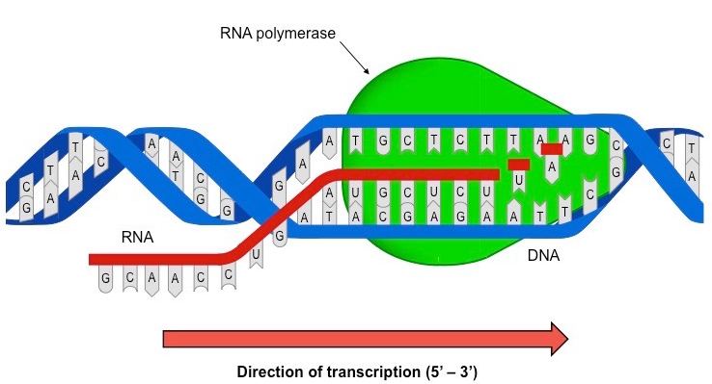
Notes:
See how mRNA is the same as the strand it is not copying??
Which is the sense strand and which is the antisense?

Slide 15
Post Transcription Modification
Capping
Addition of a methyl group to the 5’ end
Protects against degradation by exonucleases
Polyadenylation
Addition of a poly-A tail to the 3’ end
Improves the stability of the RNA transcript and facilitates its export from the nucleus.
Splicing
Introns are removed
Exons are fused together

Slide 16
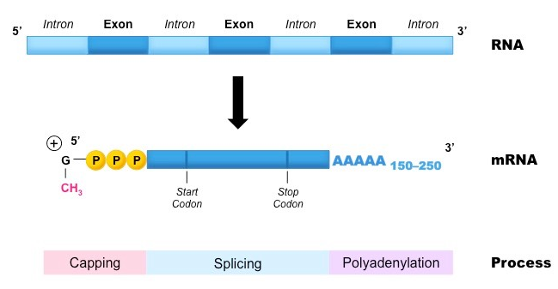
Post-transcription Modification
Notes:
5’ cap: Made of a modified guanine nucleotide with three phosphates.
Poly-A tail: composed of 150-250 Adenine nucleotides
Both protect the mature mRNA from degradation in the cytoplasm.

Slide 17
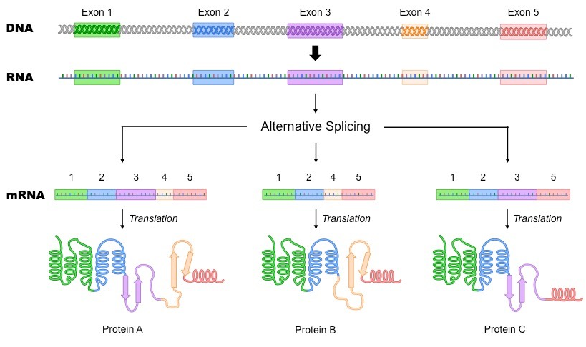
Alterative Splicing
Notes:
Alternative Splicing - different pieces may be introns at different times, and exons may be rearranged - means 1 gene can code for more than one protein

Slide 18
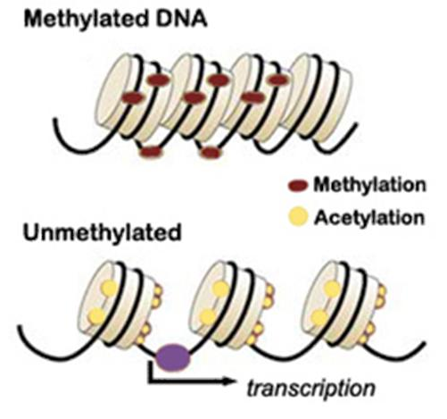
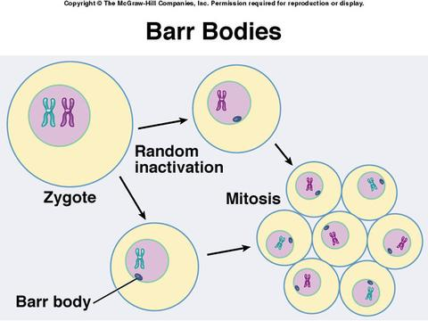
Gene Expression
Inactive DNA is highly methylated compared to DNA that is being transcribed.
A methyl group is an organic functional group (CH₃).
Ex. X chromosome in mammalian females.
The inactive X chromosome is heavily methylated and are not usually transcribed or expressed.
Once methylated it will stay this way even through cell division.

Slide 19
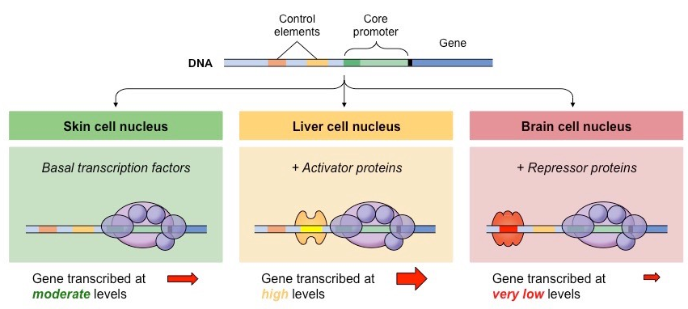

Slide 20
Control Elements
The DNA sequence that regulatory proteins bind to are called control elements
Some control elements are located close to the promoter while others are more distant.
Regulatory proteins typically bind to distal control elements, whereas transcription factors usually bind to promoter elements.
Most genes have multiple control elements and hence gene expression is a tightly controlled and coordinated process.

Slide 21
Environment
Notes:
Himalayan rabbit produces different fur pigment on the temperature
Humans produce different amounts of melanin
Some fish, reptile and amphibians can change gender.

