Slide 1
7.3 Translation

Slide 2
AUG
Start codon

Slide 3
Understandings:
Initiation of translation involves assembly of the components that carry out the process.
Synthesis of the polypeptide involves a repeated cycle of events.
Disassembly of the components follows termination of translation.
Free ribosomes synthesize proteins for use primarily within the cell.
Bound ribosomes synthesize proteins primarily for secretion or for use in lysosomes.
Translation can occur immediately after transcription in prokaryotes due to the absence of a nuclear membrane.
The sequence and number of amino acids (a.a.) in the polypeptide is the primary structure.
The secondary structure is the formation of alpha helices and beta pleated sheets stabilized by hydrogen bonds.
The tertiary structure is the further folding of the polypeptide stabilized by interactions between R groups.
The quaternary structure exists in proteins with more than one polypeptide chain.
Applications:;
tRNA-activating enzymes illustrate enzyme-substrate specificity and the role of phosphorylation.
Skills:
The use of molecular visualization software to analyze the structure of eukaryotic ribosomes and a tRNA molecule.
Identification of polysomes in an electron micrograph.

Slide 4
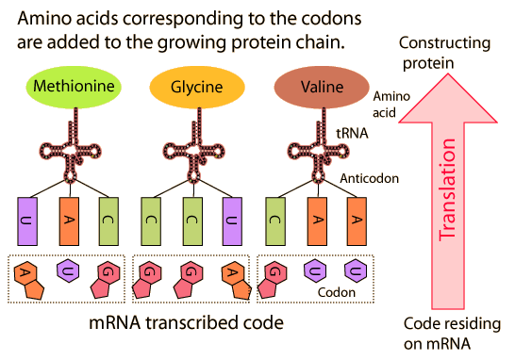
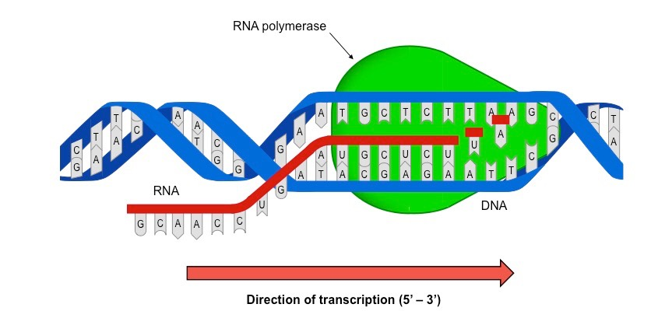
Overview
Replication: Makes a copy of DNA
Transcription: Makes RNA from DNA
Translation: Makes proteins

Slide 5
Overview
Replication: Makes a copy of DNA
Transcription: Makes RNA from DNA
Translation: Makes proteins

Slide 6
Overview
Replication: Makes a copy of DNA
Transcription: Makes RNA from DNA
Translation: Makes proteins

Slide 7
Overview
Replication: Makes a copy of DNA
Transcription: Makes RNA from DNA
Translation: Makes proteins

Slide 8
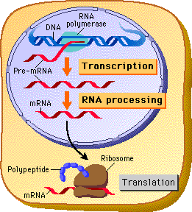
mRNA
mRNA acts as a carrier from the nucleus

Slide 9
mRNA
mRNA acts as a carrier from the nucleus

Slide 10
mRNA
mRNA acts as a carrier from the nucleus
A template in the ribosomes where proteins are made.

Slide 11
mRNA
mRNA acts as a carrier from the nucleus
A template in the ribosomes where proteins are made.

Slide 12
Steps to build a protein
1. Initiation (AUG codon)
2. Elongation (polypeptide chain)
3. Termination (release of polypeptide chain)

Slide 13
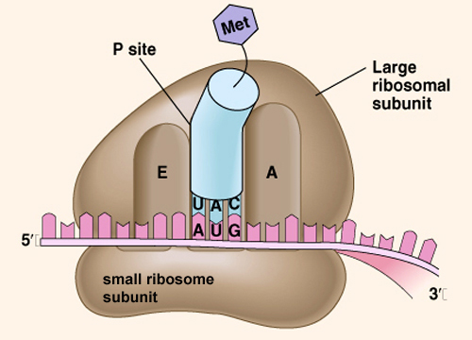
Initiation
Ribosome made of a small subunit and a large subunit will surround mRNA.
The small subunit binds first.
Move along mRNA until it finds the “start”
AUG is the start codon.
Large subunit will bind (sites)
UAC (anticodon) brings Met.
Notes:
Draw mRNA with AUG “start” and tRNA
A site: Aminoacyl site ← First Site
P: Peptidyl site
Exit

Slide 14
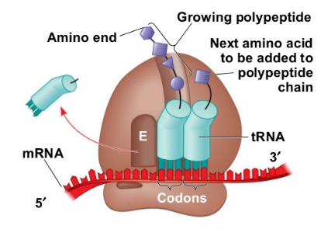
Elongation
Notes:
What kind of bond is formed between amino acids?? Peptide Bond

Slide 15
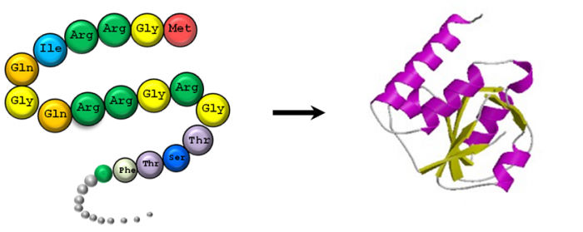
Termination
Eventually the ribosomes will reach the “stop” codon.
The polypeptide chain will detach, and fold into a protein.

Slide 16
But…how does amino acids get to the ribosome??
tRNA

Slide 17
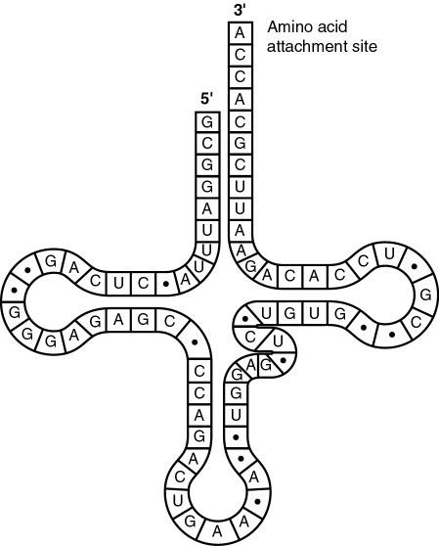
tRNA (transfer RNA)
Brings in amino acids.
Very specific, only brings in one a.a.
After it has “dropped” off its amino acid, it must recharge.
tRNA activating enzyme, which is also specific base on each tRNA.
Remember what enzymes do?? They help catalyze reactions.
Notes:
(r) Loop of 8 nucleotides
(l) Loop of 7 nucleotides
Extra loop
Anticodon: complementary to mRNA strand
CCA terminal site: site for attaching a.a. (t is CCA not ACC because a.a. are added in the 5’ to 3’ direction)
~ enzyme gives tRNA it’s temporary happily ever after.

Slide 18
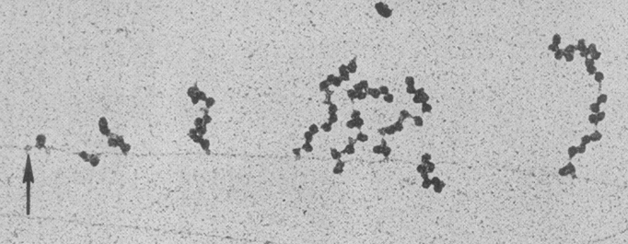
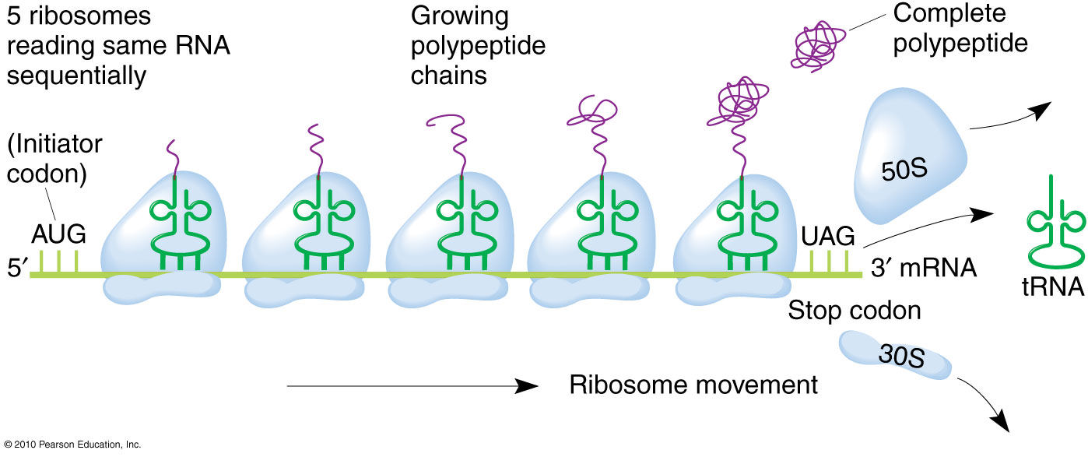
Polysomes
Several ribosomes can translate one mRNA strand at the same time, producing multiple proteins at the same time.
Notes:
Electron microscope

Slide 19
Eukaryotes vs Prokaryotes
Prokaryotes can simultaneously carry on transcription and translation at the same time.
Eukaryotes cannot.
Why do you think that is??

Slide 20
Lets Try Everything together
DNA strand
TACAAAGAATAACAAAAGATC
mRNA strand

Slide 21
UGA
Stop codon

Slide 22
In your groups…decode the DNA messages!

Slide 23
On Friday…..multicultural show!!!

