Slide 1
Trashketballin’
Oceanography KW Science: Villa
Unit 1 Review

Slide 2
Just a few things about the exam:
Test will be Monday, September 19th.
Test includes multiple choice and short answer questions.
Bring a pencil!!
I will be here after school today if you would like to stay for extra help.

Slide 3
Group Rules:
Groups of 3!!
You may choose your own groups.
When you get into your groups, assign each person a number 1-3:
  George is 1, Tammy is 2, Sally is 3, etc.
  Write this on the sticky note Ms. Villa provides along with your team name.
  After each group has a number, come up with a team name.
  You will have 3 min to do this.

Slide 4
Trashketball rules
You will work in groups of 3.
Each member MUST write the answers on the white board when their turn is up.
  Round 1=person 1, Round 2=person 2, Round 3=person 3, etc.
At the end of the countdown, show your answers to me.
Groups with the correct answer shoot for additional points (the person who shoots is the same person who wrote for that round).
Each member must shoot during their turn.
5 second shot clock
Unsportsman-like conduct will result is loss of points.
Winning team gets bragging rights (and a treat).

Slide 5
Lets practice:
What sections will you be tested on?

Slide 6
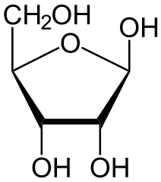
What type of macromolecule is pictured below?
Notes:
Carbohydrate: Ribose

Slide 7
Name the molecule in the picture below.
Notes:
Carbohydrate: Ribose

Slide 8
A triglyceride is made up of ________ and ____ (#) ________.
Notes:
Glycerol and 3 fatty acids

Slide 9
Draw a picture of a glucose molecule.

Slide 10
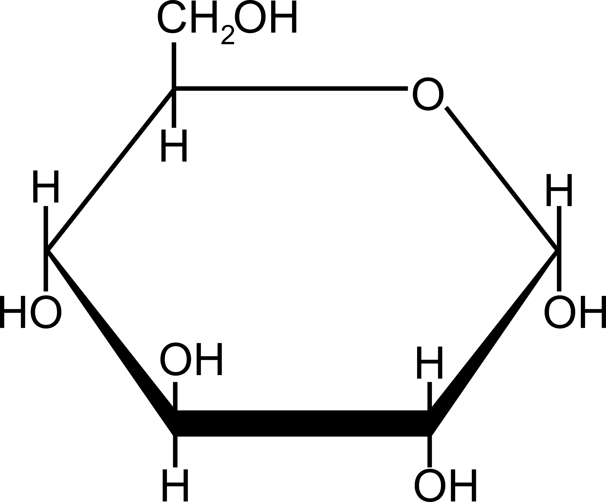
Answer: Draw a picture of glucose.

Slide 11
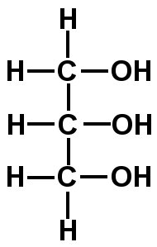
Which molecule is pictured below?

Slide 12
Compare and contrast anabolism and catabolism.
Notes:
Anabolism: Using smaller molecules to build larger ones. Water leaves these reactions as a result of bonding the monomers together. This results in water as a product.
Catabolism: Breaking down polymers into smaller molecules such as monomers. This reaction is also known as hydrolysis. Water is needed to bread the bonds between monomers in order to separate them.

Slide 13
Draw a picture of a Condensation reaction between the monomers and polymers of a carbohydrate.

Slide 14
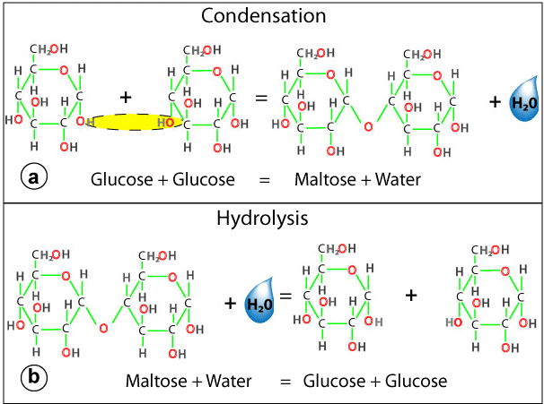
Answer: Draw a picture of a Condensation reaction between the monomers and polymers of a carbohydrate.

Slide 15
Draw a picture of a Hydrolysis reaction between the monomers and polymers of a carbohydrate.

Slide 16
Answer:

Slide 17
List an example of a monosaccharide.
Notes:
Glucose, galactose, fructose, ribose

Slide 18
List an example of a Disaccharide.
Notes:
Maltose, lactose, sucrose

Slide 19
List an example of a polysaccharide.
Notes:
Starch, glycogen, cellulose, chitin

Slide 20
Compare and contrast lipids and carbohydrates with reference to energy storage.
Notes:
Big idea: Carbs=short term energy
Lipids=long term energy

Slide 21
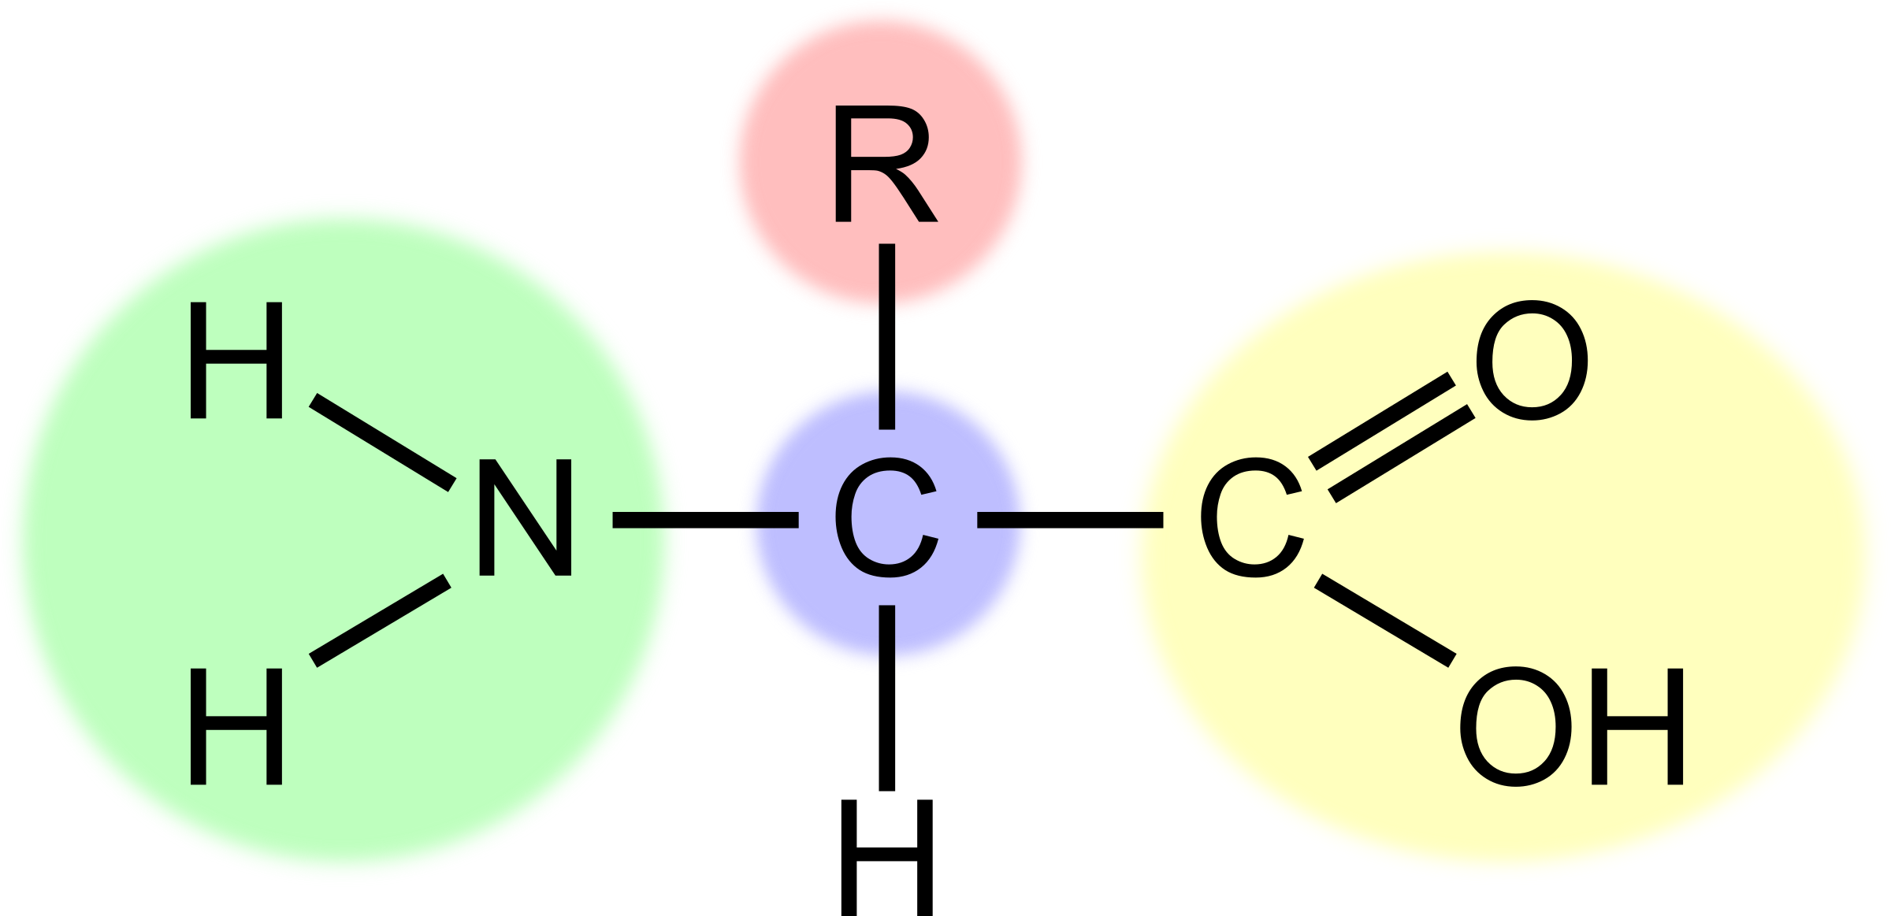
What is pictured below?
Notes:
Amino Acid

Slide 22
Which structure is highlighted in green?
Notes:
Amino Group

Slide 23
Which structure is highlighted in Yellow?
Notes:
Carboxyl group

Slide 24
Explain the significance of the amino group and the carboxyl group when forming a polypeptide.

Slide 25
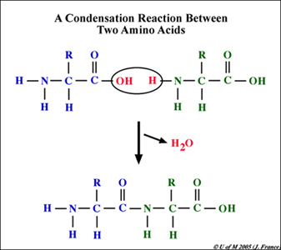
Explain what is happening in this picture:

Slide 26
Answer: Explain what is happening in this picture:
Notes:
The picture is showing how a peptide bond is formed between two amino acids. The OH on the carboxyl group and the H from the amino group detach from the amino acids and release water. The resulting amino acids then bond covalently forming a peptide bond between the two amino acids.

Slide 27
Give two examples of an organic molecule.

Slide 28
Draw a picture of 2 water molecules interacting with one another. Include your labels!

Slide 29
Describe hydrolysis. Give an example.

Slide 30
Explain the thermal properties of water.

Slide 31
How is water able to transport molecules throughout the body?

Slide 32
What is the difference between saturated and unsaturated fatty acids?

