Slide 1
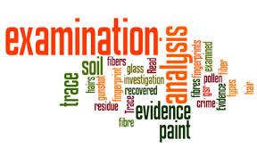
Evidence

Slide 2
Classification of Evidence
Testimonial Evidence: statement made under oath
  direct evidence
  eyewitness evidence*
Physical evidence: any object or material that is relevant in a crime
  “real” evidence
  Examples:hair, fiber, fingerprints, documents, blood, soil, drugs, toolmarks, impressions, glass
  physical and chemical properties

Slide 3
Reliability of eyewitnesses
Factors that affect accuracy:
  Nature of the offense and the situation in which the crime is observed
  Characteristics of the witness
  Manner in which the information is retrieved
Additional factors:
  Witness’s prior relationship with the accused
  Length of time between the offense and the identification
  Any prior identification or failure to identify the defendant
  Any prior identification of a person other than the defendant by the eyewitness

Slide 4
Physical evidence
Is generally more reliable than testimonial evidence
Can prove that a crime has been committed
Can corroborate or refute testimony
Can link a suspect with a victim or with a crime scene
Can establish the identity of persons associated with a crime
Can allow reconstruction of events of a crime

Slide 5
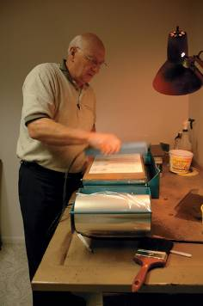
Reconstruction
Physical evidence can be used to
answer questions about:
  What took place at a crime scene
  The number of people involved
  The sequence of events
A forensic scientist compares the
questioned (Q) (unknown) sample
from the crime scene with a
sample of known (K) origin.

Slide 6
Types of Physical Evidence
Transient evidence
Pattern evidence
Conditional evidence
Transfer evidence
Associative evidence

Slide 7
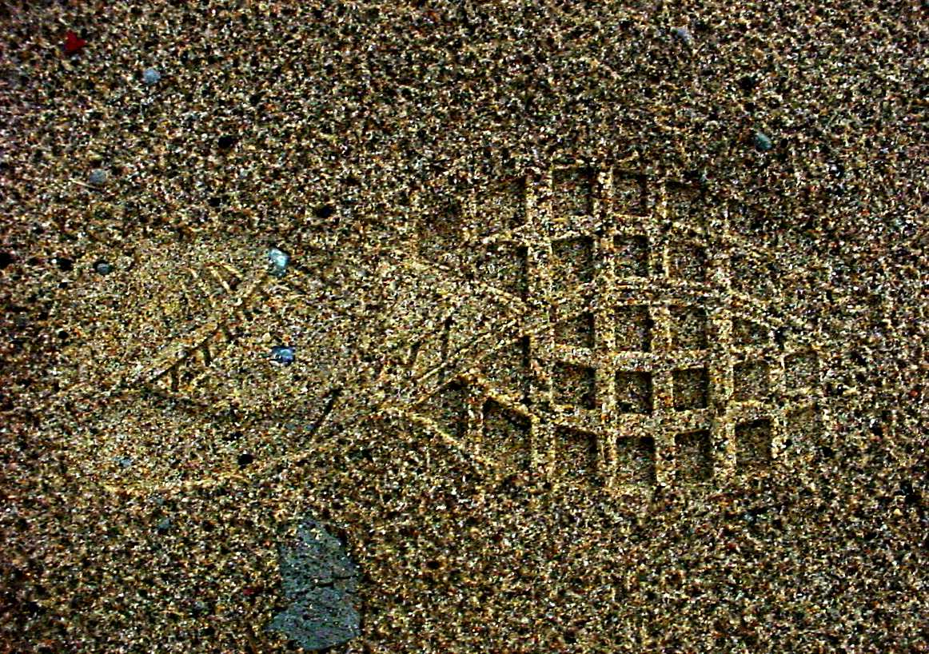
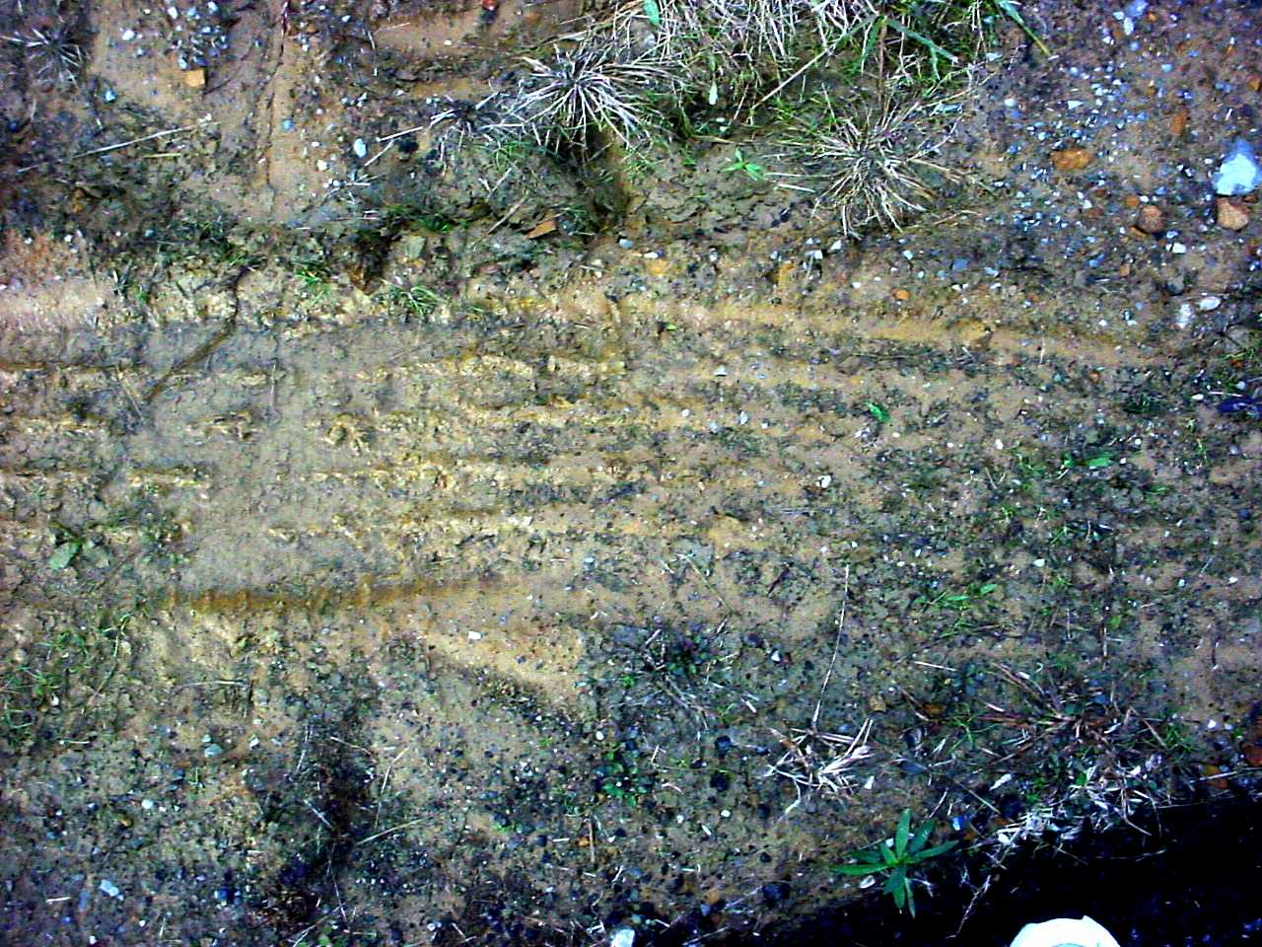
Transient Evidence
Temporary
Easily changed or lost
Usually observed by the first officer at the scene.
Examples:
  Odor—putrefaction, perfume, gasoline, urine, burning, explosives, cigarette or cigar smoke
  Temperature—surroundings, car hood, coffee, water in a bathtub, cadaver
  Imprints and indentations— footprints, teeth marks in perishable foods, tire marks on certain surfaces

Slide 8
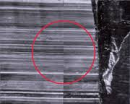

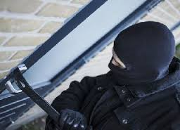
Pattern Evidence
Produced by direct contact between a person and an object or between two objects
Mostly in the form of imprints, indentations, striations, markings, fractures, or deposits
  Blood spatter
  Glass fracture
  Fire burn pattern
  Furniture position
  Projectile trajectory
  Tire marks or skid marks
Clothing or article distribution
Gunpowder residue
Material damage
Body position
Toolmarks
Modus operandi

Slide 9
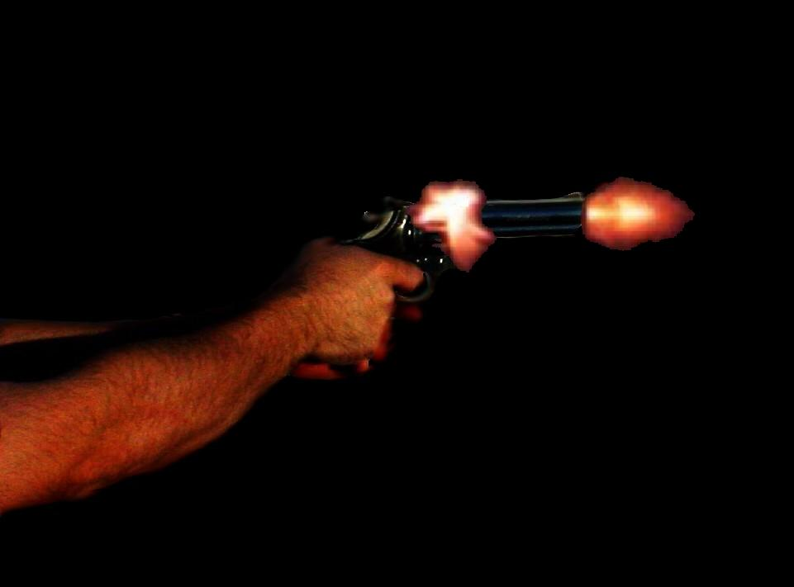
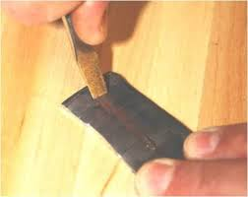
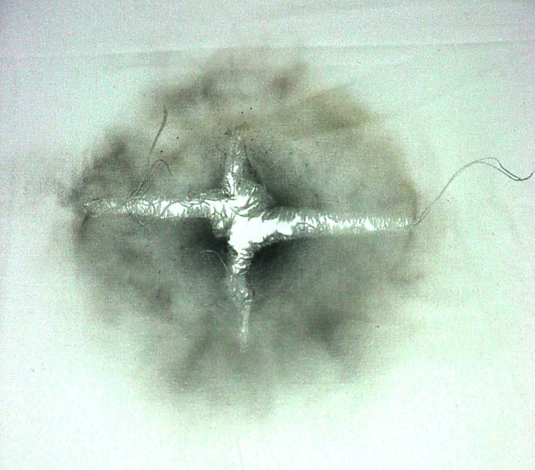
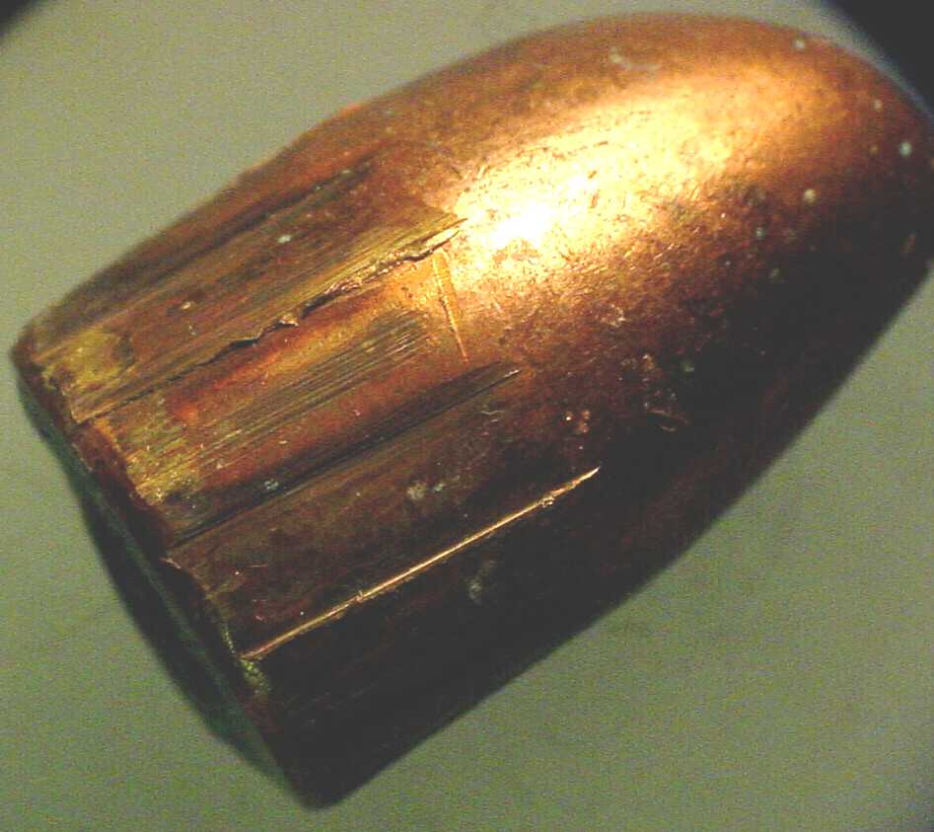
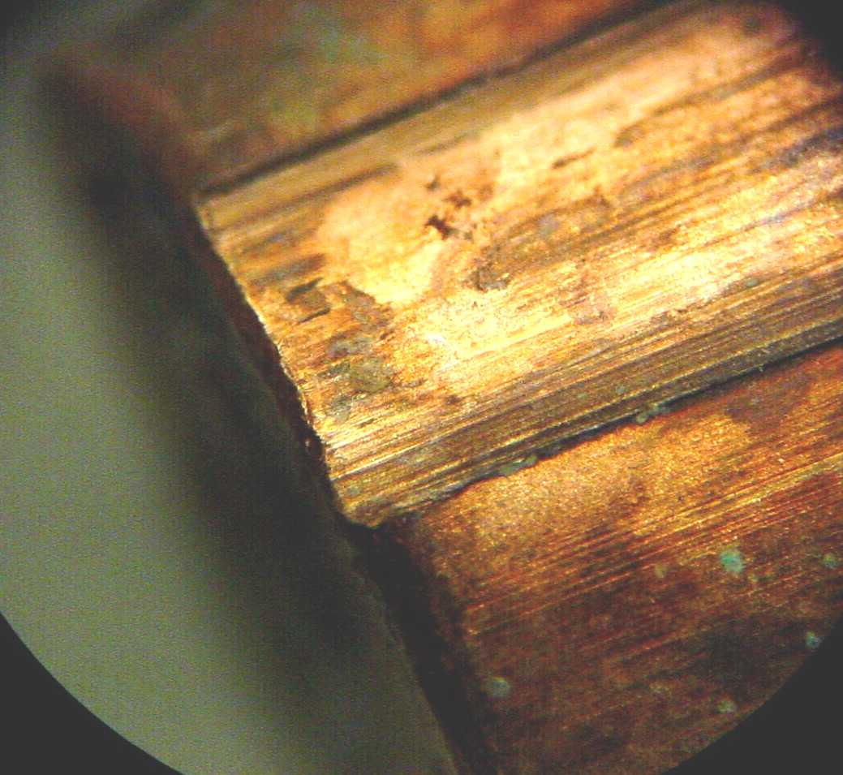
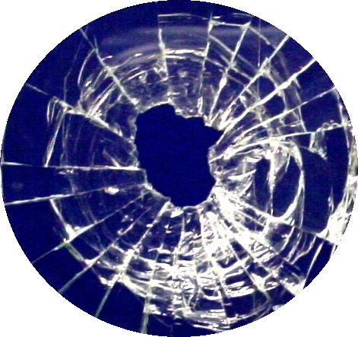
Pattern evidence

Slide 10
Conditional Evidence
Produced by a specific event or action
Important in crime scene reconstruction, determining circumstances or event sequence
indirect evidence
Light—headlight, lighting conditions, lights on or off
Smoke—color, direction of travel, density, odor
Fire—color and direction of the flames, speed of spread, temperature and condition of fire
Location—of injuries or wounds, of bloodstains, of the victim’s vehicle, of weapons or cartridge cases, of broken glass
Vehicles—doors locked or unlocked, windows opened or closed, radio off or on, odometer mileage
Body—position and types of wounds; rigor, livor, and algor mortis
Scene—condition of furniture, doors and windows, any disturbance or signs of a struggle

Slide 11
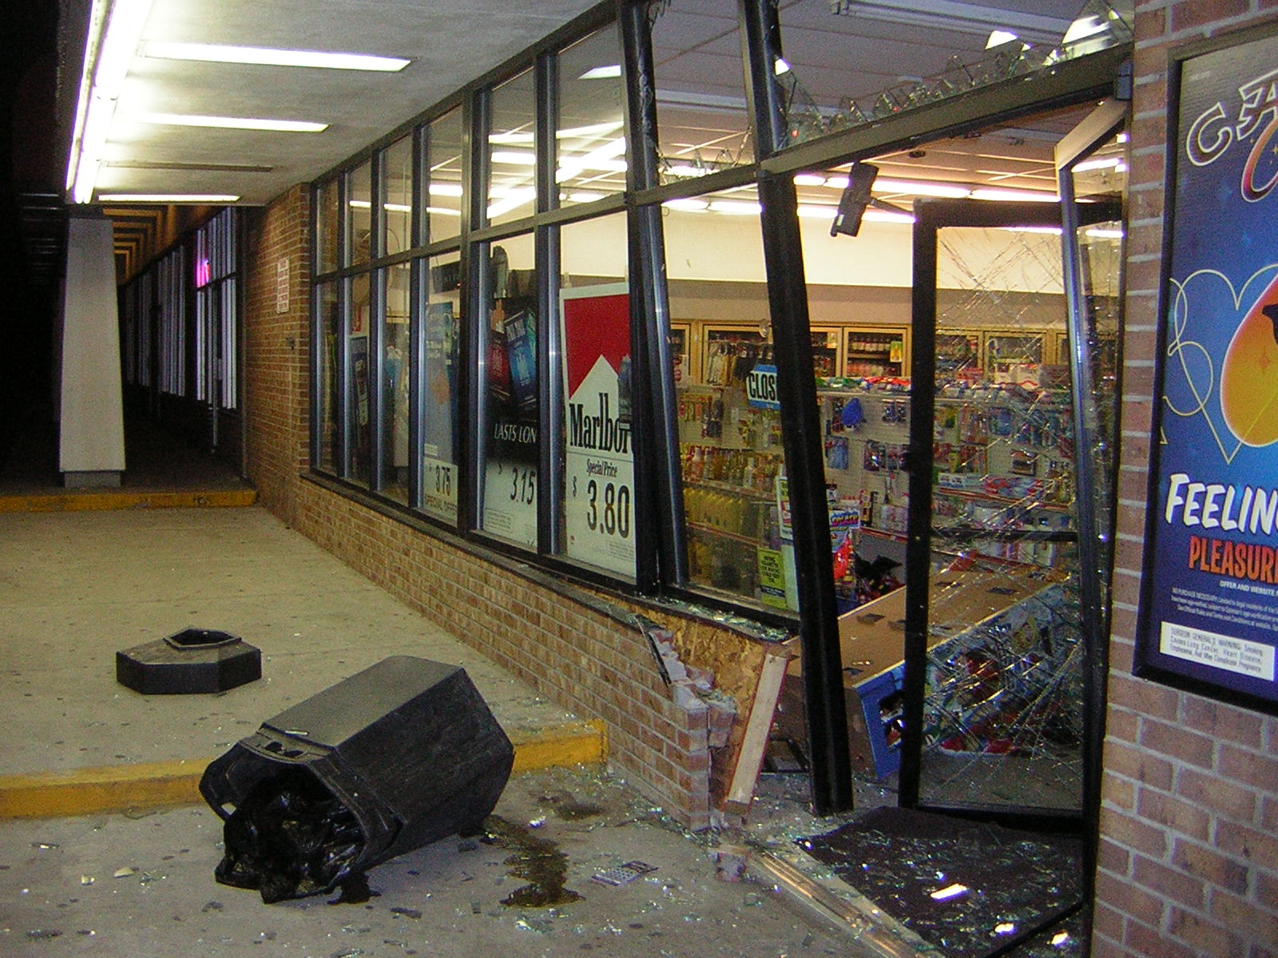
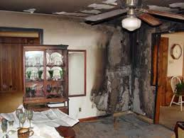

Slide 12
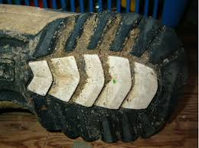
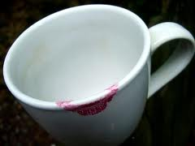
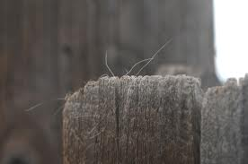
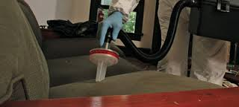
Transfer Evidence
Produced by contact between person(s) and object(s), or between person(s) and person(s).

Slide 13

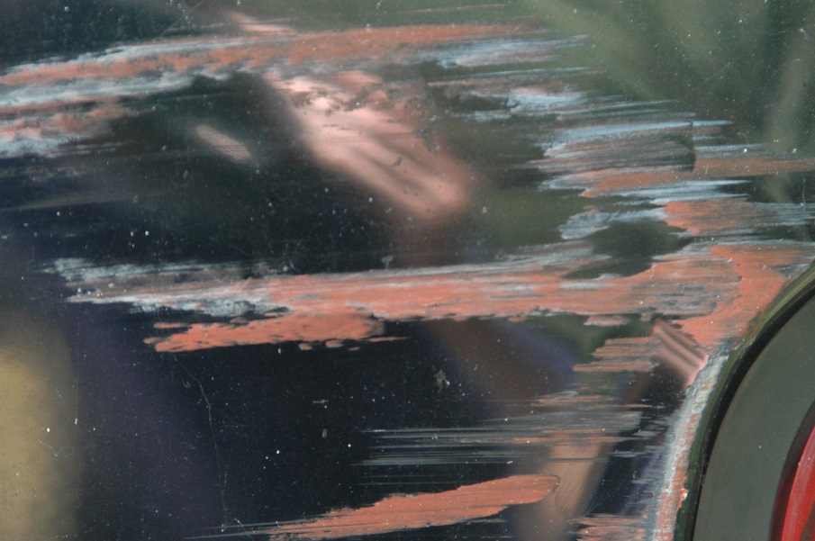

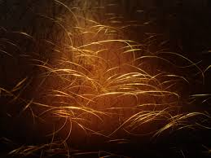
Associative Evidence
Something that may associate a victim or suspect with a scene or with each other; e.g., personal belongings.

Slide 14
Classification of Evidence by Nature
Biological—blood, semen, saliva, sweat, tears, hair, bone, tissues, urine, feces, animal material, insects, bacteria, fungi, botanical material
Chemical—fibers, glass, soil, gunpowder, metals, minerals, narcotics, drugs, paper, ink, cosmetics, paint, plastic, lubricants, fertilizer
Physical—fingerprints, footprints, shoeprints, handwriting, firearms, tire marks, tool marks, typewriting
Miscellaneous—laundry marks, voice analysis, polygraph, photography, stress evaluation, psycholinguistic analysis, vehicle identification

Slide 15

Individual vs. Class Evidence
Individual—can be identified with a particular person or a single source
Class—common to a group of objects or persons
  relies on statistics!
Fingerprints
Blood DNA Typing

Slide 16
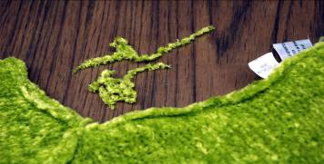
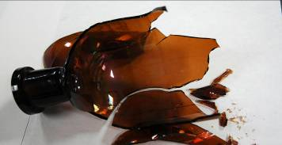
Individual vs. Class Evidence
These fibers are class evidence; there is no way to determine if they came from this garment.
The large piece of glass fits exactly to the bottle; it is individual evidence.

Slide 17
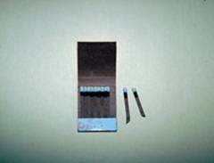
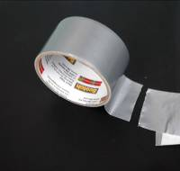

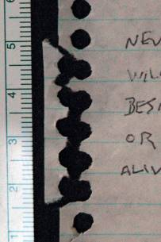
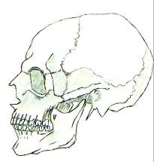
Individual vs. Class Evidence
Which examples do you think could be individual evidence?

Slide 18
Steps in a Forensic Investigation
Recognition
Preservation
Identification
Comparison
Individualization
Interpretation
Reconstruction

Slide 19
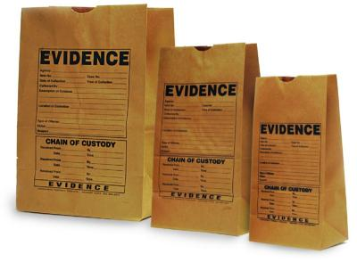
Steps in a Forensic Investigation
Recognition of evidence
  the ability to distinguish important evidence from unrelated material
  pattern recognition
  physical property observation
  information analysis
  field testing
Preservation of evidence
  collection
  proper packaging

Slide 20
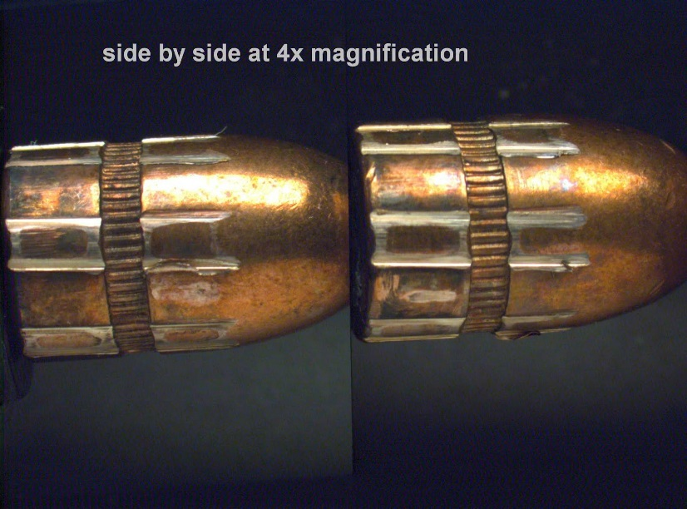
Steps in a Forensic Investigation
3. Identification of evidence: scientific testing of…
          physical/chemical properties
          morphology
          biological and immunological properties
4. Comparison of evidence
          class characteristics measured against those
          of known standards or controls
          if all measurements are equal, then the two samples may be considered to have come from the same source or origin

Slide 21
Steps in a Forensic Investigation
5. Individualization of evidence
            demonstrating that the sample is unique, even among members of the same class
6. Interpretation of evidence
          giving meaning to all the information
7. Reconstruction of the crime
          Inductive and deductive logic
          Statistical data
          Pattern analysis
          Results of laboratory analysis

Slide 22
