Slide 1
Bell Ringer
Describe what an enzyme is.

Slide 2
Unit 1 Review

Slide 3
Give me an example of qualitative data.

Slide 4
Give me an example of quantitative data.

Slide 5
What are the characteristics of living things?

Slide 6
How does one obtain nutrition?

Slide 7
A water molecule is composed of ……
Notes:
Two hydrogen, one oxygen

Slide 8
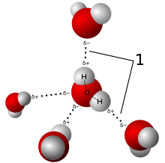
What type of bond is #1 referring to?

Slide 9
What property of water allows it to stick to other things?

Slide 10
What is a polar molecule, what does that mean?

Slide 11
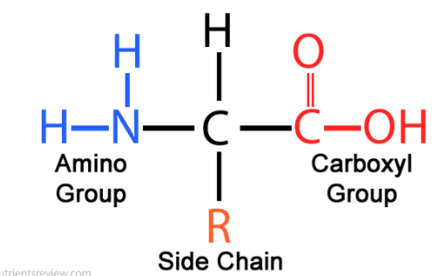
What class of macromolecule is this image?

Slide 12
What are the building blocks of proteins?
Notes:
Amino acids

Slide 13
What are the building blocks of carbohydrates?
Notes:
sugars

Slide 14
What are the reactants? What are the products?

Slide 15
The energy needed for a reaction to start is called……

Slide 16
Enzymes are what type of macromole?

Slide 17
Enzymes function as what? They speed up reactions.

Slide 18
If I give you chocolate and want to know how that affects your exam score.
Which is the dependent variable?
Which is the dependent variable?

Slide 19
Compare the 4 macromolecules.

Slide 20
What are the different levels of proteins?

Slide 21
What questions do you have?

