Slide 1
Bell Ringer
Why is water necessary for life?

Slide 2
Properties of water

Slide 3
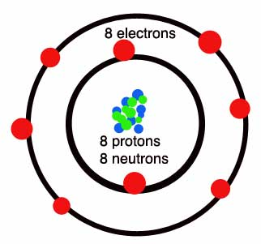
First, lets look at a oxygen atom.
In the nucleus, you will find protons and neutrons.
In the out shells you will find electrons.
Proton: Positive charge
Neutron: Neutral charge
Electron: negative charge.

Slide 4
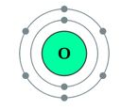
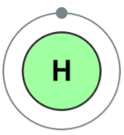
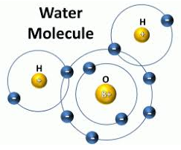
Formation of a water molecule
Reactants Product

Slide 5
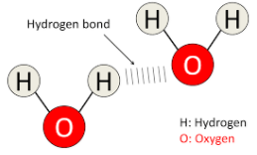
Water Molecule
Covalent bonds are formed within a water molecule.
Covalent: sharing of electrons
Unequal sharing gives rise to polarity.
Ionic bond: transfer of electrons
Water is a polar molecule.
Because of the polarity, water molecules can form hydrogen bonds.
Hydrogen bonds are weaker than covalent bonds.
But in great number they can form a strong bond as a whole.
Notes:
1 oxygen molecule
2 hydrogen molecules
Talk about polarity

Slide 6
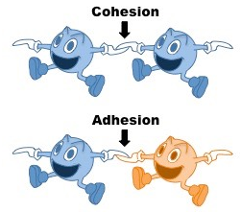
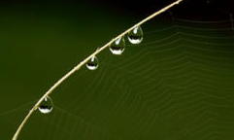
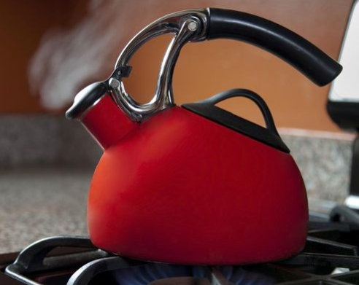
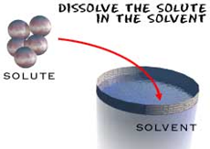
Properties of water (because of hydrogen bonds)
Cohesion: water sticking to water molecule
Adhesion: water sticking to a different molecule.
Heat capacity: takes a lot of energy to raise the temp of water.
Universal solvent: water is able to dissolve and transport materials.

Slide 7
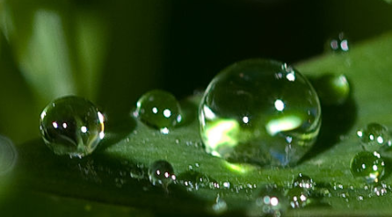
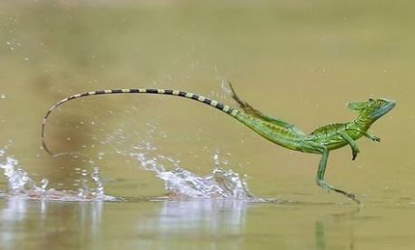
Cohesion
Cohesion is an attraction between molecules of the same substance.
Cohesion causes water to be drawn together.
Cohesion also produces surface tension.
Polarity gives rise to cohesive properties.

Slide 8
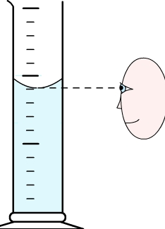
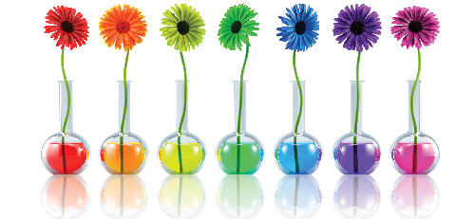
Adhesion
Adhesion is the attraction between molecules of different substances.
The attraction between water and glass is greater than between water and water.
Capillary action is one of the forces that draws water out of roots of a plant and up into the stems and leaves.

Slide 9
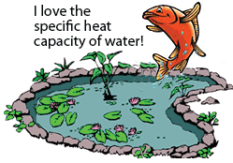
Heat Capacity
Because of the hydrogen bond, it takes a lot of heat energy to get the water molecules to move faster, which raises the temperature of water.
This allows large bodies of water to absorb large amounts of heat with only a small change in temperature.

Slide 10
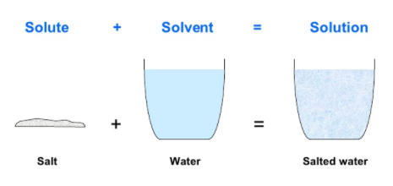
Solutions (Universal Solvent)
Water is not always pure.
Solutions: . Type of mixture in which all components are evenly distributed.
Solute: substance that is dissolved in a solution.
Solvent: dissolving substance in a solution.

Slide 11
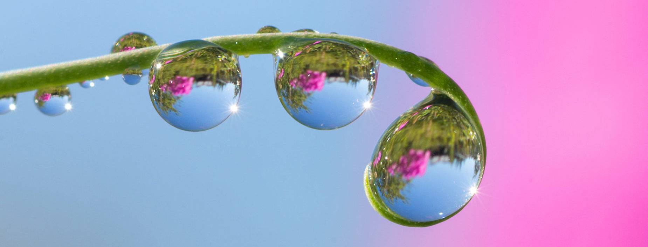
Lets test your knowledge!!

Slide 12
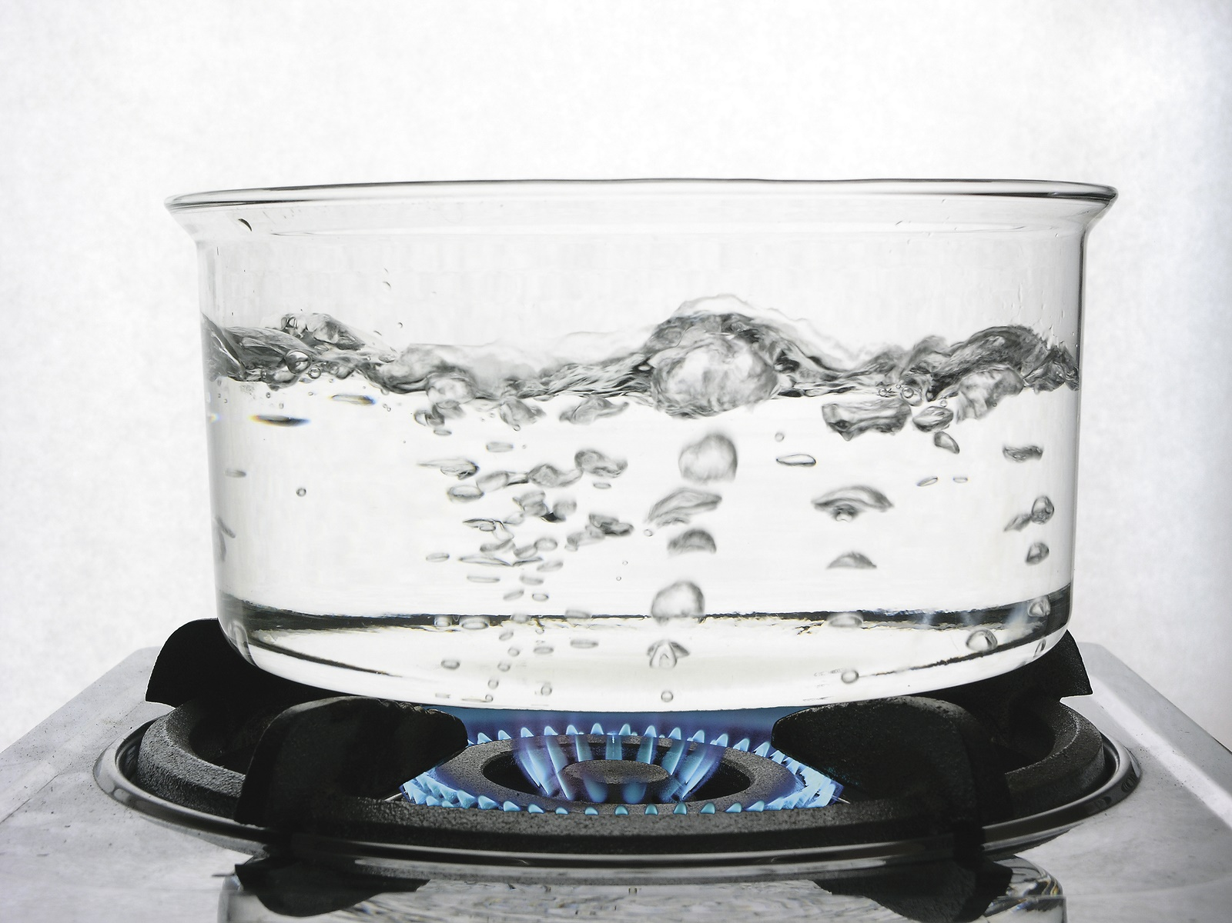

Slide 14
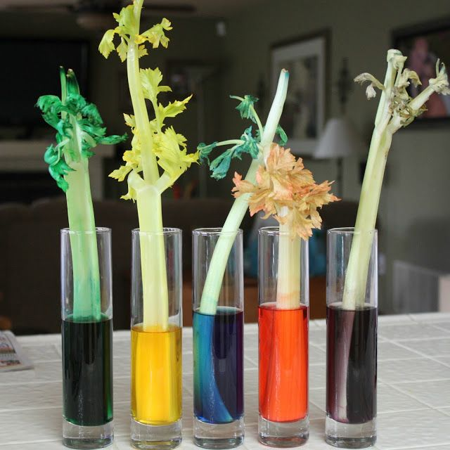

Slide 15
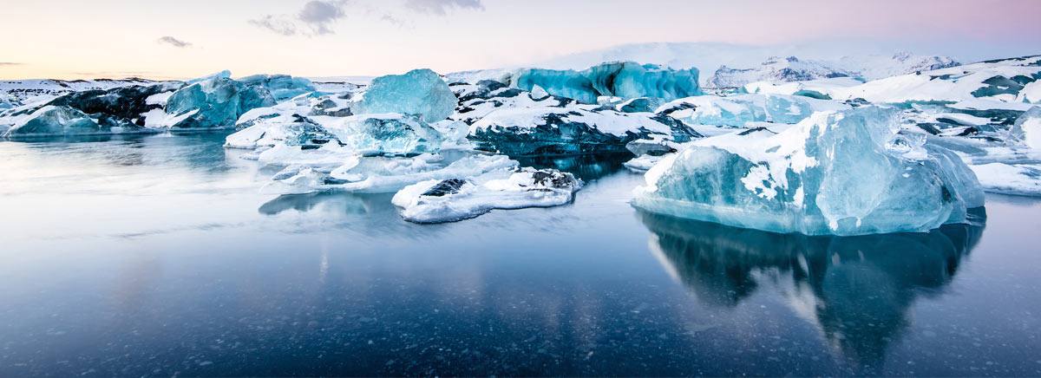
Tricky…..

Slide 16
Water Graphic Organizer
You will create a 4 quadrant diagram to illustrate the properties of water.
20 minutes to finish.

